Slide 1
Using the SIM for the campus card
Frans Panken, Joost van Dijk

Slide 2
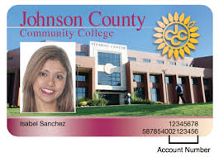
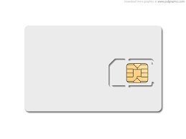
Problem description
Security officer, Data protection officer
Printing, scanning
Meal plans,…
coffee machines
Library facilities
Mobile subscriptions
Access control
Notes:
procurement

Slide 3
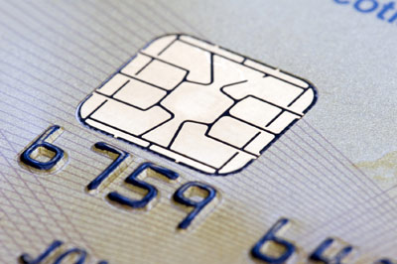
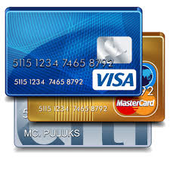
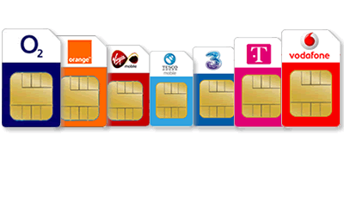
What is a smartcard?
Contains an embedded microprocessor
Has a operating system
Has readable and writable access memory
Has a serial interface and may receive power from external sources (card readers)
Standardized by Global Platform
Autonomous secure system
Notes:
Smart cards may provide personal identification, authentication, data storage, and application processing.
Synonyms: Smartcard / chipcard / integrated circuit card
Contactless/contact

Slide 4
Problem description
Security officer, Data protection officer
Authentication, 2factor
Lockers,…
Printing, scanning
Internet of Things
Meal plans,…
,coffee machines
Library facilities
Mobile subscriptions
Access control

Slide 5
Institutions benefit from a common smartcard design
A ‘standardized’ campus card
Making use of a common system architecture
Using security as a starting point
Compatible with existing solutions
Manageable and upgradable
● Future proof: accreditation, IoT, indoor coverage, …
● Institution in control over their own card, the
security keys and the management

Slide 6
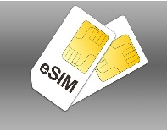
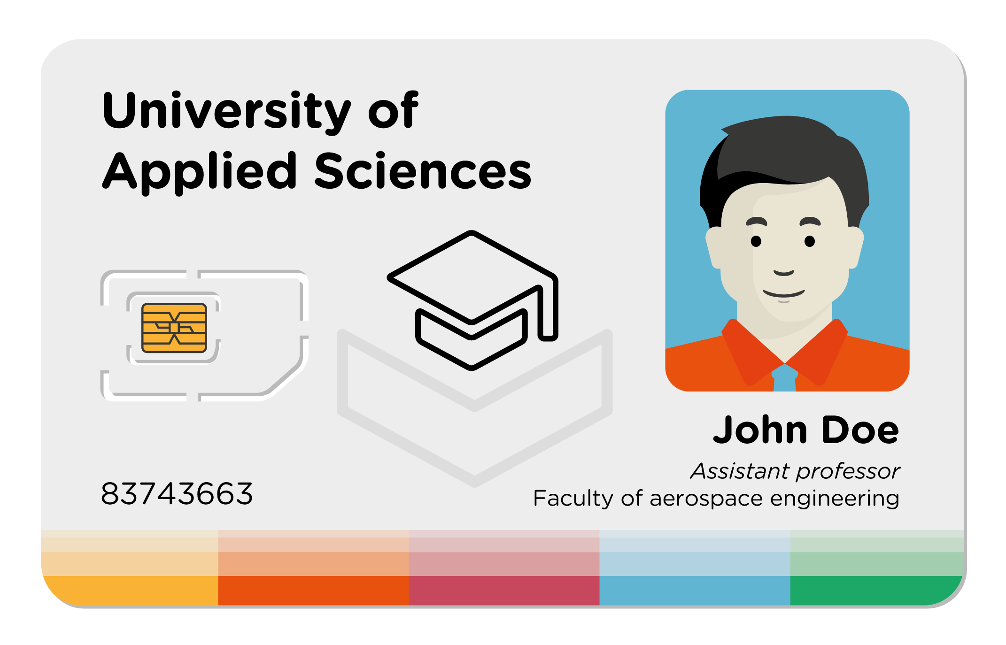
Integrate the SIM on the campuscard

Slide 7
E-SIM – high level design
General Keys
Telco level
MNO 1
MNO 2
MNO 3
Applet level
App 1
App 2
App 3
App 4

Slide 8
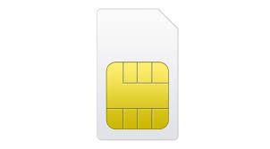
Dividing the SIM in two parts
Part #1 : Mobile operator profiles
Mobile infrastructure: - Voice - 3G/4G data - SMS/M2M
Indoor communication: - Bad indoor coverage - Internet of Things - Unified Communications
Part #2 smart card management
Design campus card
Security keys within corporate HSM
Over-the-air provisioning
Institution’s security domain
Applet management for secure apps on device or machine

Slide 9
E-SIM as one of the building blocks, enablers on the campus card
The E-SIM potentially:
Provides an autonomous secure system: Separates applets from operator profiles; ownership of security domain
Provides the flexibility of remotely changing network operator profiles and perform card management
Can provide secure authentication for Wi-Fi, MulteFire, Private LTE, 5G, LoRa, LTE-M,…
Can be used to delegate security for several applications in smartphones / tablets
Notes:
1) Autonomous system: Separate applets from operator profiles; ownership of secure security domain, by strictly separating the operator profiles from the applets, we create by design a tapered ability to manage and deploy (and procure) these functionalities separately: one via the E-SIM deployment platform (SM-DP and LDP interactions) and a TSM for the management of applets.
2) separately and independently from profiles
4) No one side fits all solution: they still may be a need for a plastic card. Using the E-SIM for campus card has advantages over using separate plastic cards: non-technical: easier for the person (
technical: management of user accounts, immediate activation of changes (with current smartcards only some of the readers have the ability to update cards)
The true merit lies in realizing a common future-proof architecture for a hardware-based isolated environment that can be used in various devices (including plastic cards) and allows building a common and tamper-resistant security solution that can be audited.

Slide 10
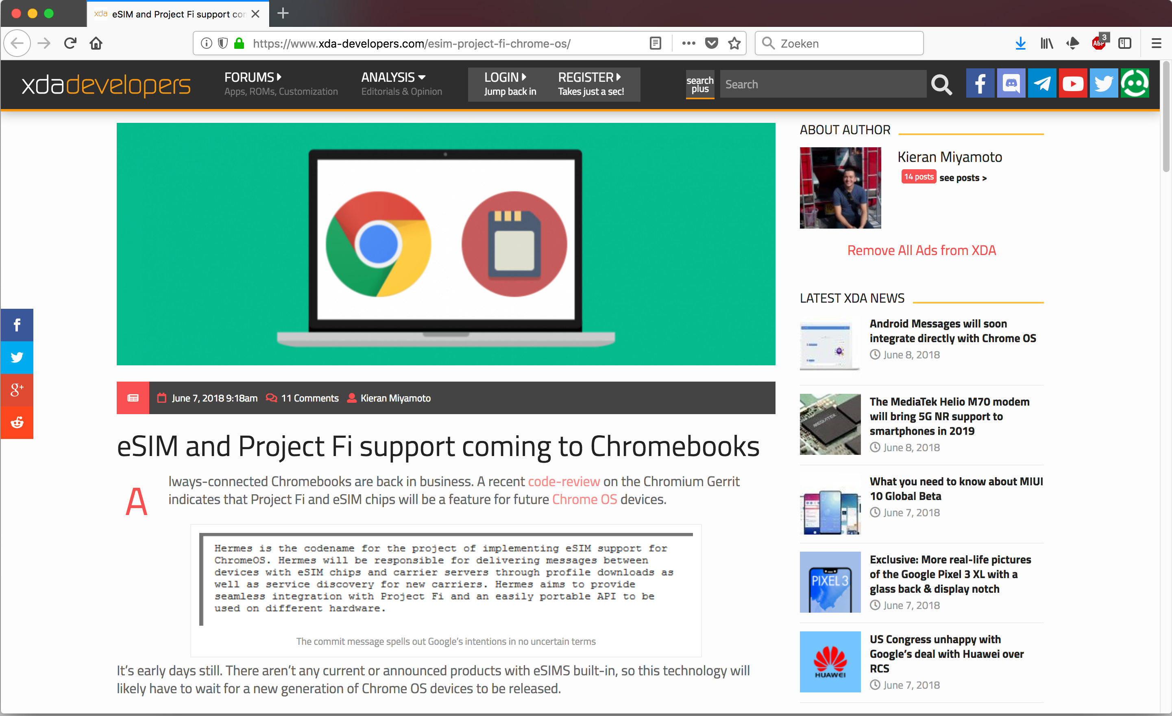
Google puts E-SIMs in Chromebooks…?

Slide 11
Innovations on SIMs
Android 5 and higher: API to access the applets on the SIM
Mifare cards: Classic, plus, DesFire,… Mifare4Mobile
Authentication for all mobile communication protocols
Notes:
Invite operators to place SIM profiles on the institution’s campus card

Slide 12
Where are we; what are the next steps?
E-SIM pilot:
E-SIM behaves as SIM: all phones support them
Changing between operators without touching the SIM
Applications on Android phones: delegate security to applets on the E-SIM
Next steps:
Community building around smart campus card: requirements (ECCA, Government card)
Design national campus card
Pilots

Slide 13
Demo: applet on SIM to gain access to eduroam
end-to-end authentication
supplicant
write
APP
read
PIN
Wi-Fi
Access point
network
DB

