Slide 1
Performance Measuring & Monitoring
perfSONAR and PMP services in GÉANT
Antoine Delvaux - PSNC
Trondheim, Norway
13th June 2018

Slide 2
Outline
perfSONAR
What is perfSONAR?
4.0.2 in November 2017
4.1 coming up
PMP: Performance Measurement Platform
Transitioning the Small Nodes in GÉANT project
Multi-domain Monitoring Expertise & Consultancy
Some examples of support we’ve provided:
NORDUNet
JISC training
UNINETT support to DragonLab project
PRACE

Slide 3
What is perfSONAR?
perfSONAR is a tool to:
Set (hopefully raise) network performance expectations
Find network problems (“soft failures”)
Help fix these problems
All in multi-domain environments
Over 2000 public hosts on many different networks
See http://stats.es.net/ServicesDirectory/
These problems are all harder when multiple networks are involved
Focus on Research and Education (R&E) Networking, 1Gbps links or higher
perfSONAR provides a standard way to publish active and passive monitoring data
This data is interesting to network researchers as well as network operators
Notes:
As most of you might know …

Slide 4
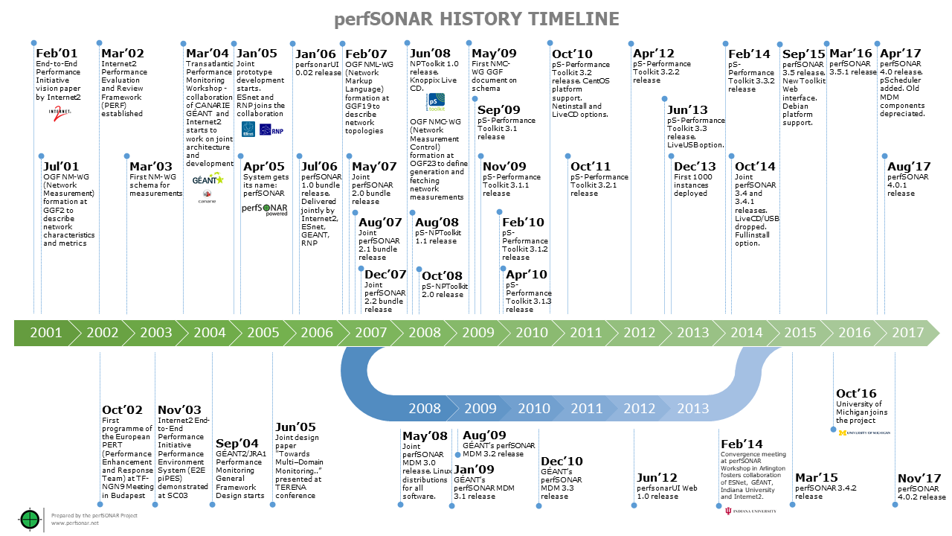
Notes:
https://www.perfsonar.net/about/perfsonar-history-timeline/

Slide 5
perfSONAR an international collaboration project
First ideas around 2001: 17 years of collaboration
By the R&E for the R&E
More info on http://www.perfsonar.net
Now 5 partner organisations:
ESnet
GÉANT
Indiana University
Internet 2
University of Michigan

Slide 6
perfSONAR 4.0.2 — Nov. 2017
Bug fixes … but not only, quite a few pScheduler enhancements
Streaming archiving for decreased CPU usage
SNMP plugins
snmp-get to collect data
snmptrap to archive measurements
jq support: online JSON manipulation
Archivers
Limit system
Contexts
Switch context before running measurement
First usage: Linux Network Namespace
Notes:
Contexts and LNN is useful for measurements in virtual environments (think MD-VPN, GTS, …)

Slide 7
perfSONAR 4.1
TWAMP
Two Way Active Measurement Protocol
Similar packets to OWAMP, better measurement accuracy than ping
Routers and Switches can act as servers (reflectors)
Integrated with pScheduler and toolkit
2 metrics: latency and RTT
pScheduler
Task priorities and task rewriting
pSConfig
mesh-config re-imagined
MCA: Mesh Config Admin
A web GUI to define a perfSONAR measurement mesh
Notes:
TWAMP is useful because of accuracy, easier then 2 OWAMP measurements, more reliable than ping.
pSConfig has better integration with pScheduler, more modularity and flexibility, backward compatible with existing mesh files
MCA running inside a Docker container

Slide 8
Getting ready for 4.1
Beta out soon … final during summer
Drop support of CentOS 6 and Debian 7
Drop support of BWCTL
Keep your deployments up to date!
Run auto-updates
Notes:
We’re putting the final touches to the beta. We’re always looking at more beta testers.

Slide 9
Performance Measurement Platform (PMP)
2 years ago: perfSONAR Small Nodes in GÉANT
20 preconfigured perfSONAR nodes distributed
A public measurement mesh across the GÉANT network
Successful and more NREN are interested
Increase the deployment and the support level
New central servers
25 to 30 new nodes to cover all GÉANT NREN
Dedicated support team
Get in touch with us if your NREN does not yet have one
perfsonar@lists.geant.net

Slide 10
Multi-Domain Monitoring Expertise and Consultancy
Providing GÉANT NREN Multi-Domain Performance Monitoring expertise, advices and support
Can help with training, collaborating with eduPERT
Successful examples:
perfSONAR deployment help for NORDUNet
perfSONAR training at JISC
Support to the DragonLab project with UNINETT
Coming up: perfSONAR deployment support for PRACE
Experts available to you!
Get in touch: perfsonar@lists.geant.org

Slide 11
We’d love to hear from you!
About your perfSONAR feature requests
Post request on https://github.com/perfsonar/project
Discuss at https://lists.internet2.edu/sympa/info/perfsonar-user
About your multi-domain monitoring expertise needs
Write to perfsonar@lists.geant.org
eduPERT workshop this Thursday at TNC18
Advanced perfSONAR usage
pscheduler, nagios integration, new features, roadmap

Slide 12
antoine.delvaux@man.poznan.pl
perfsonar@lists.geant.org

