Slide 1
Why should NRENs
adopt SRE?
Notes:
Intros
[ANNA]
Why "Site Reliability Engineering"?
Because one person's mistake shouldn't sink you.
“The industrialisation of system administration”

Slide 2
"Google Scale"
Notes:
[T]
This has nothing to do with us
they have hundred of milions of users, we have hundreds of thousands
and we dont even run that many services
Anna, how many services do you run?

Slide 3
NNTP
RIP
POP
SMTP
BGP
SNMP
HTTP
Notes:
services we ran in 1997
with ~5 people
How many services do you run? Anyone know?

Slide 4
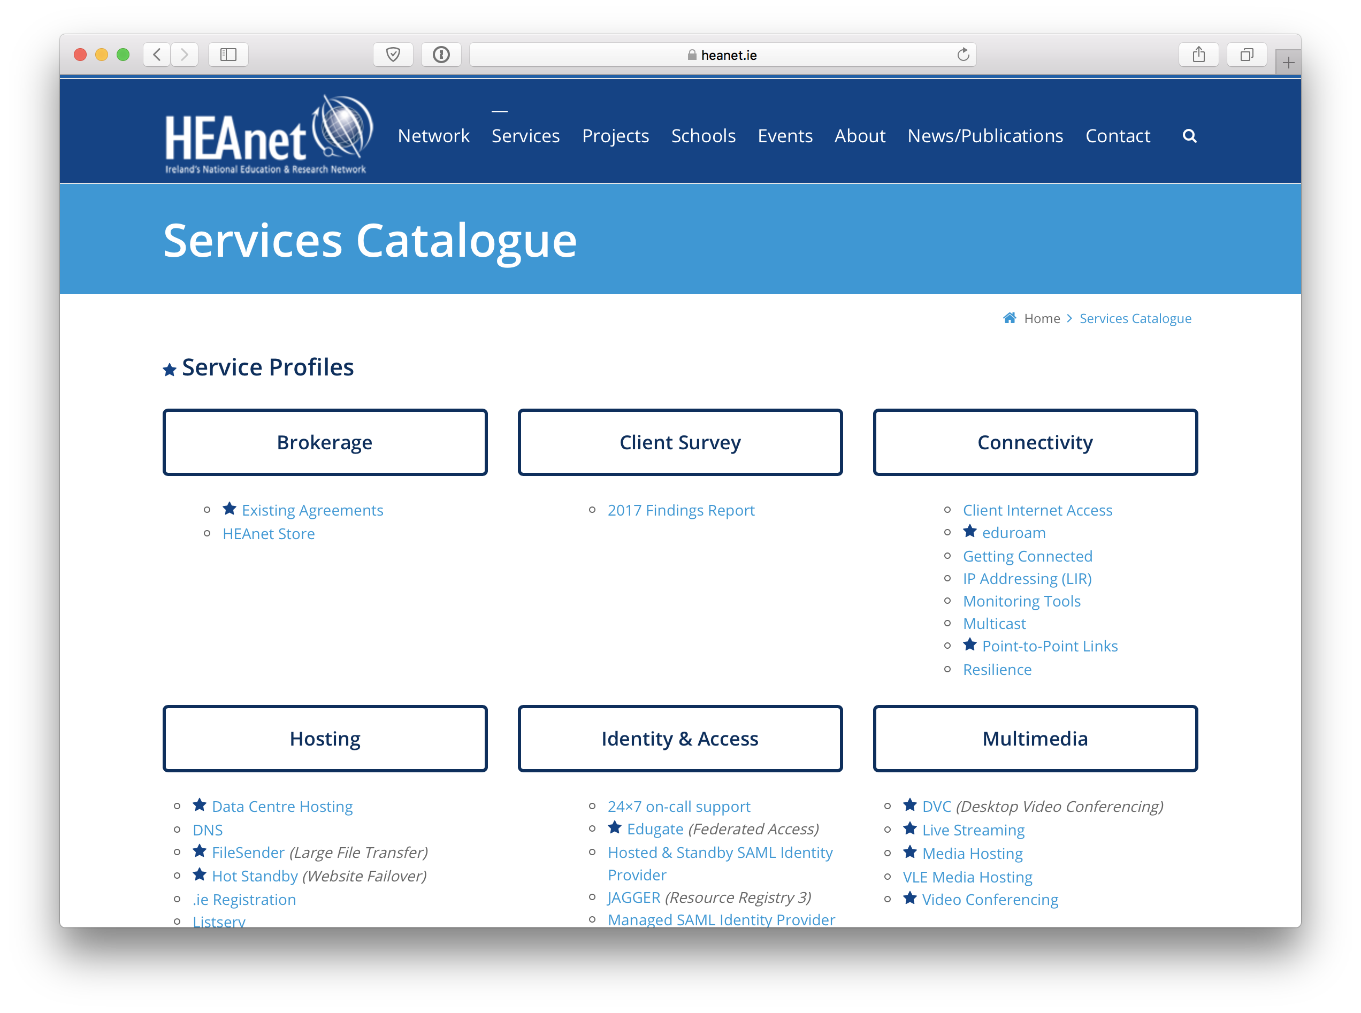
Notes:
Now, we all have a page like this

Slide 5
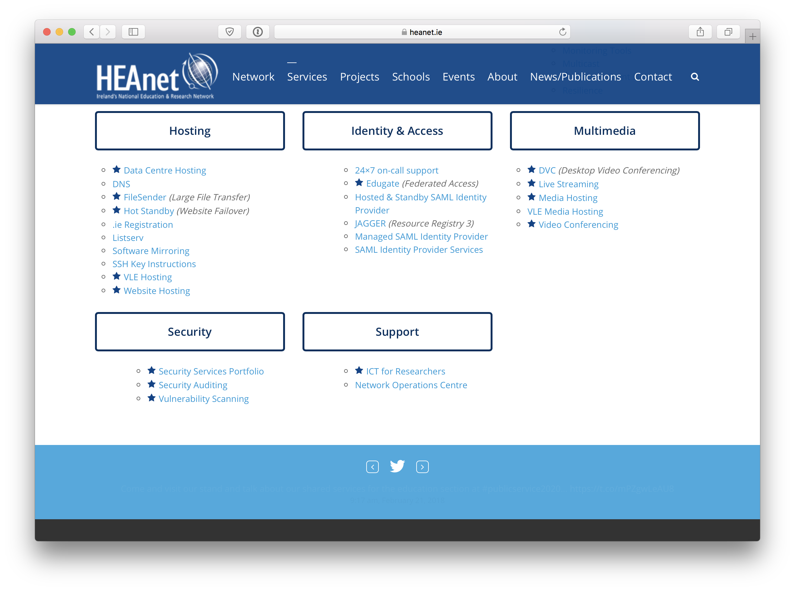

Slide 6
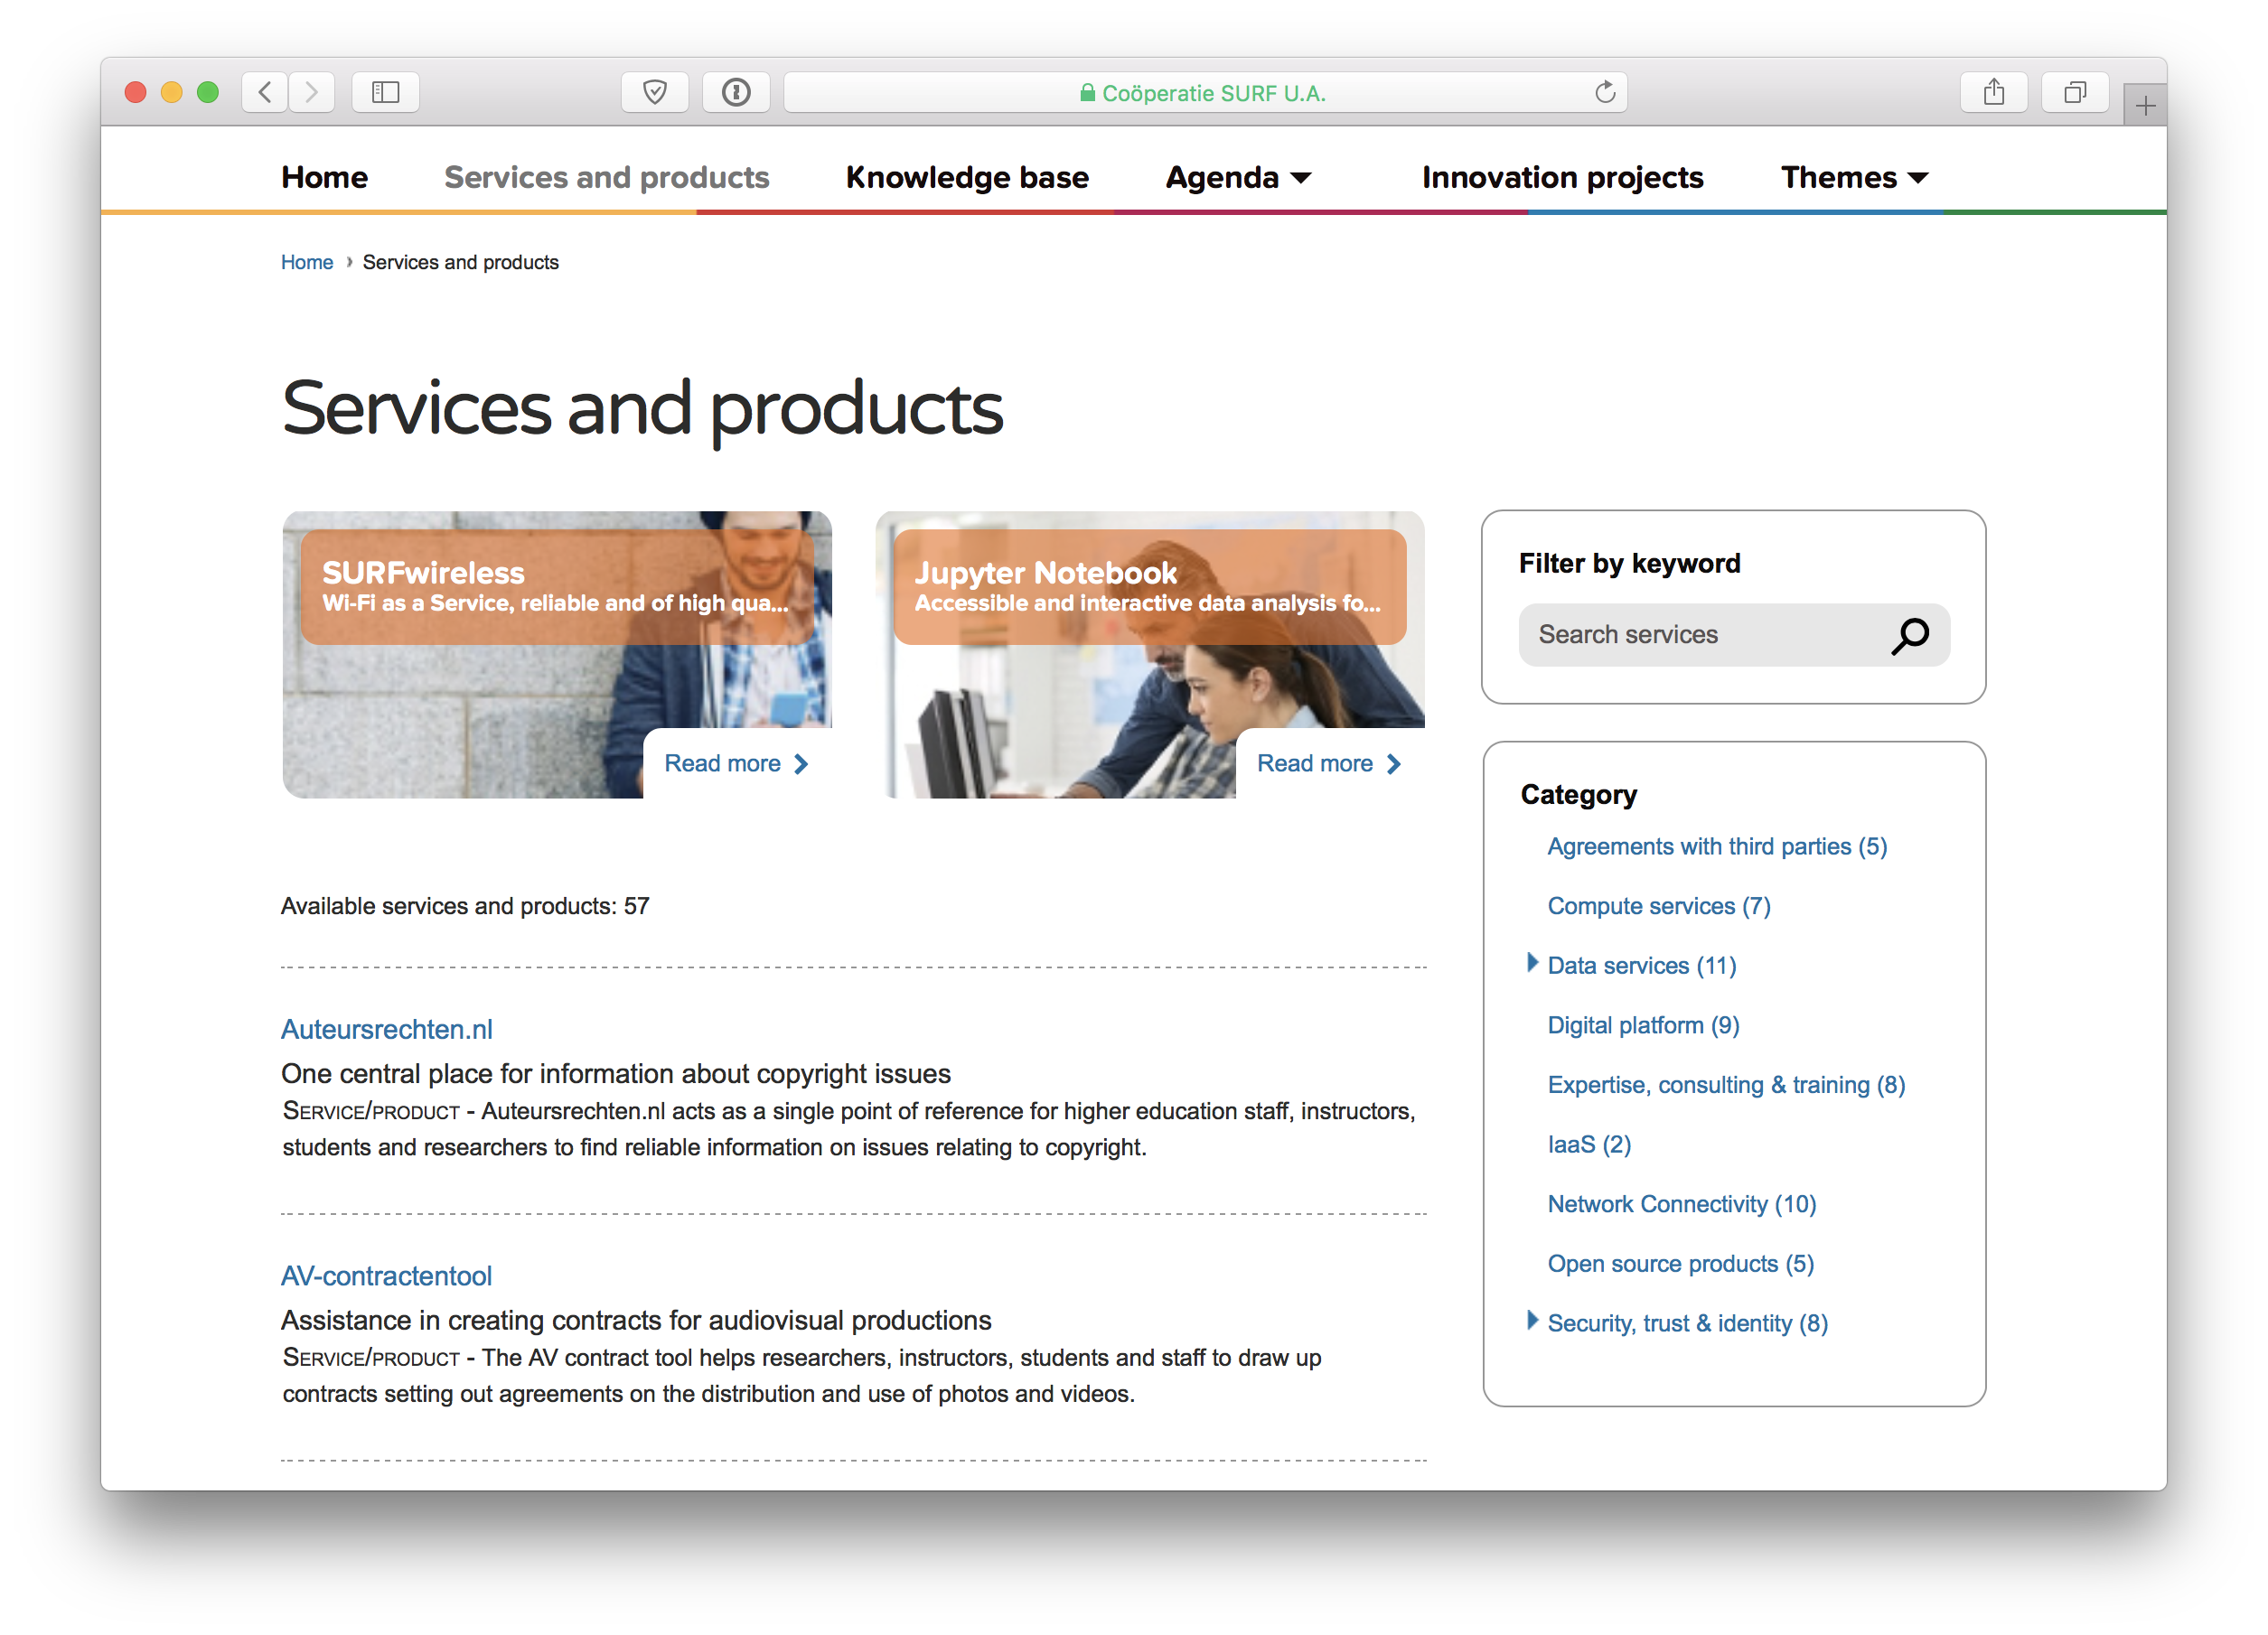

Slide 7
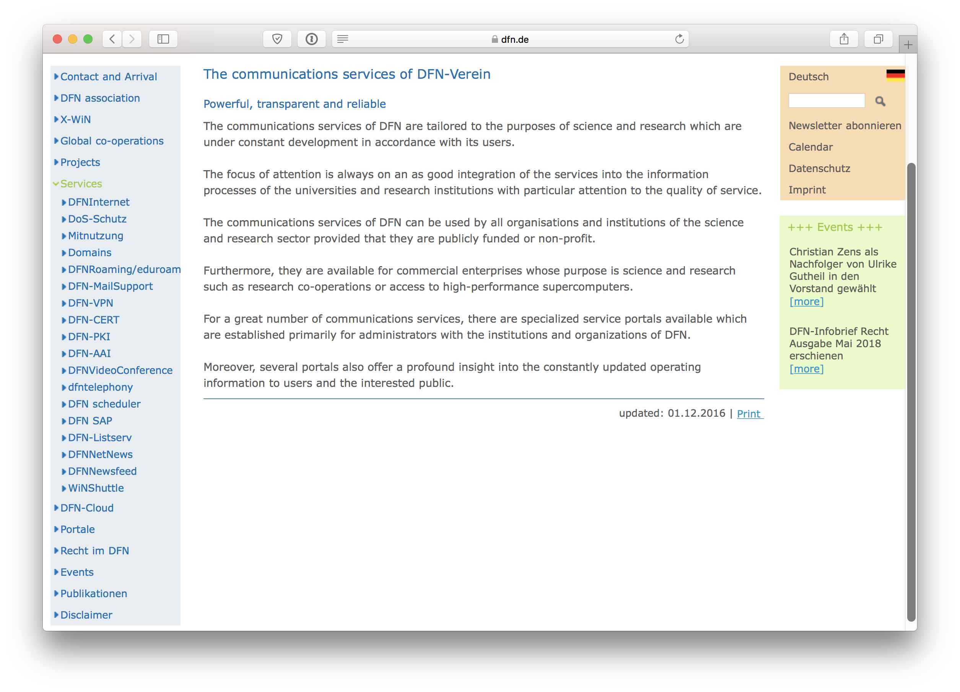

Slide 8
Services
People
Notes:
stupid graph of services scaling vs. people scaling
more services than people
“Sub-Linear Scaling”

Slide 9
"Google Scale"
Notes:
So let's look at this again.
Commercial world: scale is numbers of users
If you’ve one service for 100 million people., it had better be reliable.
It doesn't need to be perfectly up for every single person every second.
a large university is 50k people
but we need to provide them with more services than before
Is there something from the Googles of the world that we can learn?

Slide 10
Scale wide (if not deep)
More services than people
Compete with utility computing
Notes:
Why should we change?
scaling wide (if not deep)
more services than people
Services that outlive the career of a single staff member
competing with utility computing
some of our use cases are use cases they don't want
e.g. a computer for everyone in the computer science lab with BOUNDED COSTS
your user can't tell whether the NREN or Google provides the service
systemic changes: OS upgrades. Changing default gateway for 100,000 hosts, Spectre, Meltdown, patch of the week.
Turning a six month project into a pull request.

Slide 11
TOOLS
Pets
Livestock
Notes:
[T]
IF you have tens of thousands of servers, it's obvious you can't manage them by hand.
no special cases. no snowflakes. no pet names.
NRENs don’t have thousands of servers, but you’ve enough! Doing rote work isn’t fun.
You don't go "let's install some patches today" (or "it's working, don't touch it") - you have a base image and machine readable install files.
So you need a way to manage these things as a single breathing entity. (as a herd)
You lose some flexibility, because you can't just spin up a VM and install some software and serve people with it.
However, each new server isn’t new technical debt. Building a host isn’t a personal commitment. To achieve this: There needs to be a common platform.
[Anna]
WHICH WE'VE DONE BEFORE
(e.g. different approach to layer 2 circuits across NRENs - months vs minutes for provisioning)
That's not because layer 2 is good or bad; it's where you put your priorities and your process.
Things that are massive change control burdens in one situation can be very simple in another situation.
Your tooling defines your capability. Similar: the GRnet VM service.

Slide 12
What is SRE?
Notes:
[T]
WHAT CAN WE DO ABOUT IT
“The industrialisation of system administration”

Slide 13
Software development tools
to solve
systems problems
network
Notes:
but before we get there, let's talk about TOIL

Slide 14
"If a human operator needs to touch your system during normal operations, you have a bug. The definition of normal changes as your systems grow." -- Carla Geisser, Google SRE
Notes:
Toil is the work you do to stay in place.
Ever feel like that's always increasing?
A key component of SRE is reducing toil
toil is manual, repetitive, automatable, tactical, of no enduring value
(mention Common Repeatable Shareable Solutions)
"If a human operator needs to touch your system during normal operations, you have a bug. The definition of normal changes as your systems grow." -- Carla Geisser, Google SRE
(from the SRE book)
How do we get away from toil? Automation.
intent-based networking; specify what you want the state to become rather than the steps to get there
if you see things like this, and think about the google SRE way of doing things,
what falls out?

Slide 15
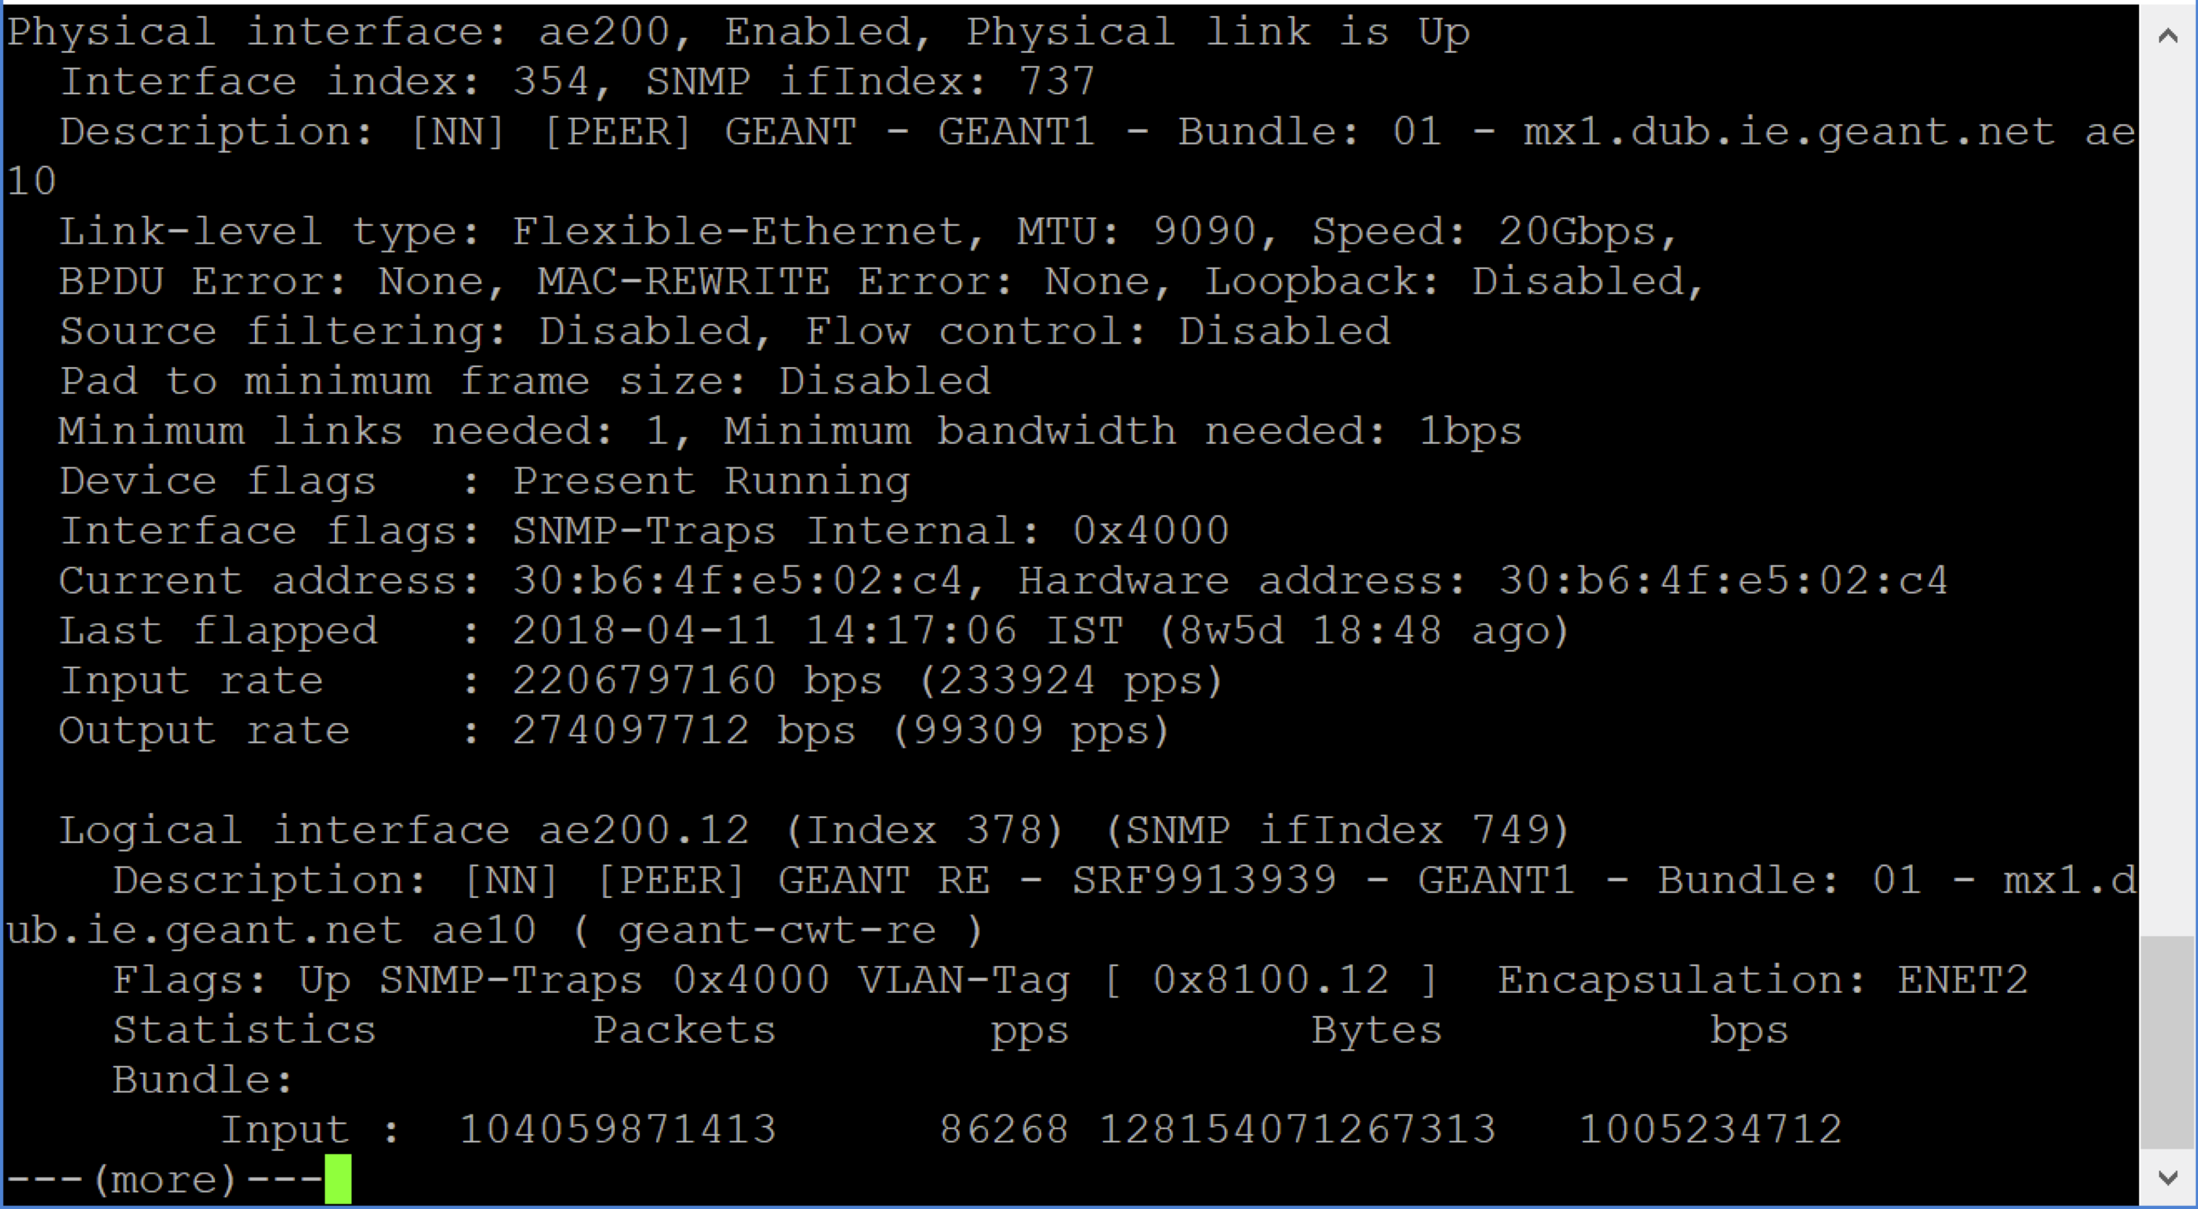
Notes:
[A]
as a sysadmin
there was a time when my job was compiling packages from source
then installing RPMs
then typing "apt-get"
then checking the emails from apticron
we still sometimes think of telnetting in and typing "sh int" as our job.
the job is to make sure the network stays running.
how else can we do that? and how do we get there from here.
[T]
[config management]
What made that possible?
don't need a wholesale shift to get there. you can go a step at a time. In fact, you MUST.
and you don't lose your skills as network engineer. you still need to know a packet on a wire to use these tools well.
PDU File system descriptors.
Fix problem at my leisure.
Know it’s fixed everywhere.
Know that handover is clean.

Slide 16
router bgp 1213
neighbour 192.0.2.1
remote-as 65535
password encrypted abcdefgh
description Sample peer
address-family ipv4 unicast
send-community ebgp
route-policy peer-in in
route-policy peer-out out
maximum-prefix 1000 75
remove-private-AS
soft-reconfiguration inbound
protocols bgp {
group external-peers-v4 {
type external;
neighbour 192.0.2.1 {
description “Sample peer”
import peer-in;
export peer-out;
family inet {
unicast {
prefix-limit 1000;
}
}
}
}
}
name: samplepeer
asn: 65535
maxprefix4: 1000
maxprefix6: 500
endpoints:
- source: ix1
dest4: 192.0.2.1
dest6: 2001:db8::1
policy:
in4: peer-in
out4: peer-out
Notes:
[A]
Config generation and deployment
e.g. Capirca - using an abstraction above the actual ACLs
(everyone runs a network with more than one vendor. there's an obvious advantage to an abstraction above the vendor's own language.
in the same logic, most of our fleets aren't completely perfectly consistent, and so it's worthwhile defining not what this server does, but what a web server looks like. Or what a server looks like! It's kernel, its repository, what's our response to Spectre and Meltdown.)
These examples are network specific, because that's in some ways the least intuitive leap; these principles all work with puppet or CFengine or anything you like.
[A explains example]

Slide 17
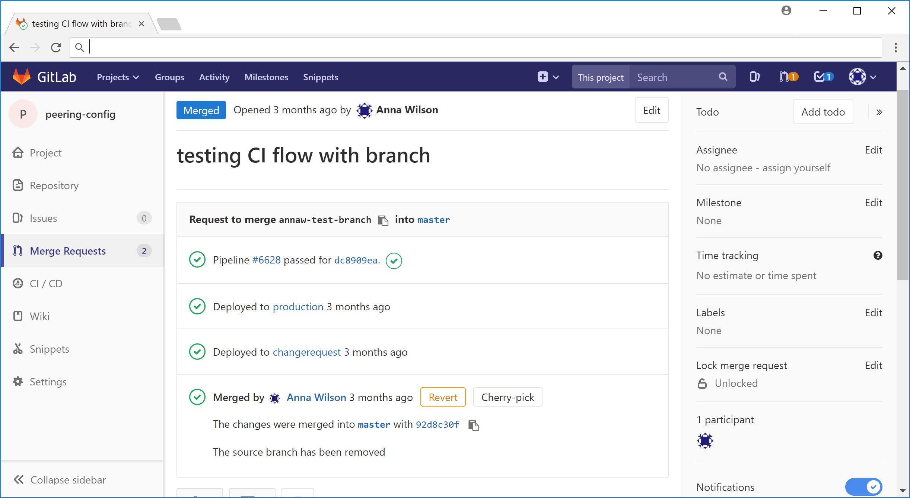
Notes:
[T]
Explain: source control with approval
canonical copy is in git, and the network is updated to reflect that - not the other way around
It takes more than one person to make a mistake. It's looked at BEFORE someone types "commit."
(Making a CR still has risk of e.g. transcription errors.)
[A explains example]

Slide 18
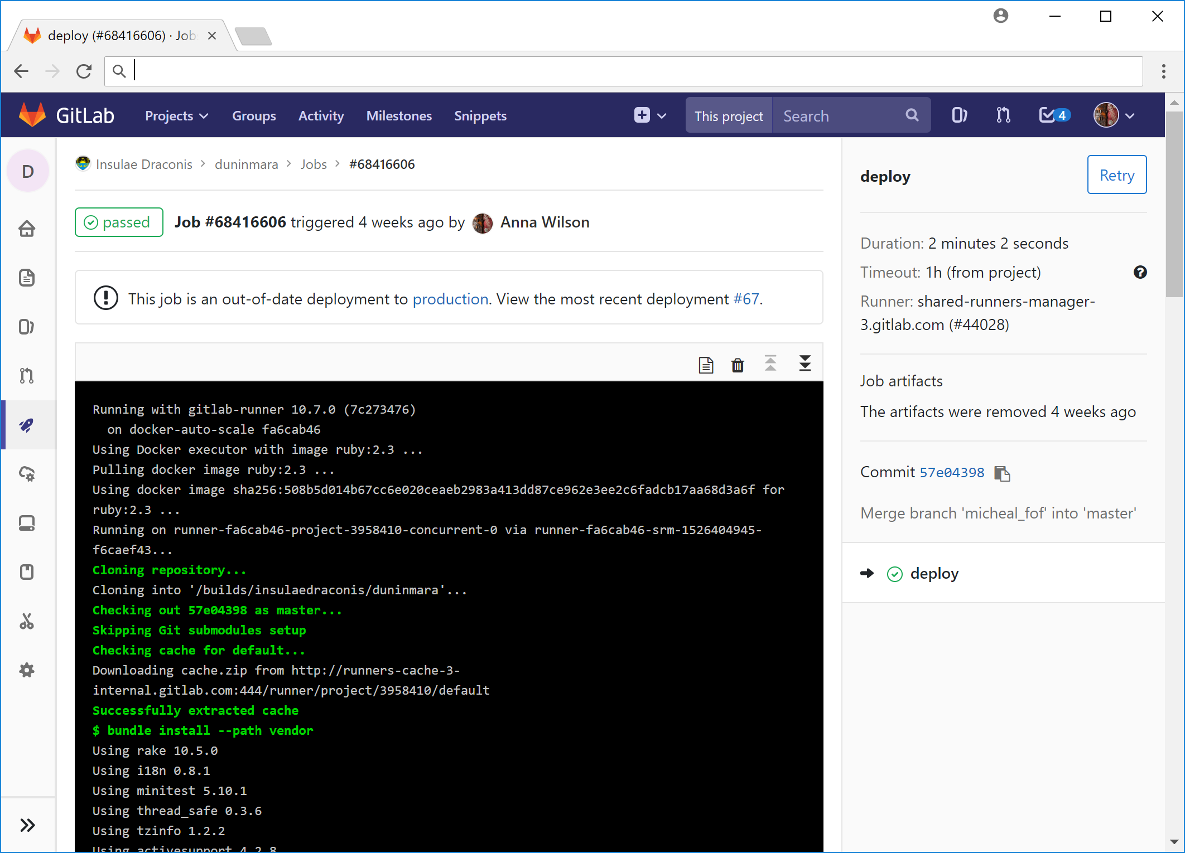
Notes:
[T]
Explain: CI/CD
CI = dynamically generate the config you want and test them
CD = put them in place
we think about them as one because that's what the tooling does
rancid was a great tool because comparing it with what's broken tells you what's wrong
what if you could test to see if the config is broken before you deploy it?
what if updating a hundred routers was the same as updating one router?
and ROLLING BACK was as easy?
[A]
push on green: if it passes the tests, it goes into production
eliminates the difference between expected state and deployed state; "undeployed code is risk"
[explains example]

Slide 19
How to get there?
Notes:
[A]
You do this a bit at a time
This is not a forklift change
Incremental changes give incremental improvements: there are things you can do to adopt SOME of it that will still give you some benefit.
You don't have to wait until it's all in to start getting benefit.
And as you deploy it, you can start automating some even cooler stuff, like tests.

Slide 20
Tests
Notes:
[T]
Simple test: an ACL should never be 20% shorter than the previous time.
Your DNS zone should not reduce in size by more than half.
[A]
More complex tests: once you have this stuff, you can spin up a virtual version of your network. It's a pretty clear path from here.

Slide 21
Forcing function
Notes:
[T]
So why do this?
We don't recreate google, or even use the same kind of tech.
We do use the same principles, and it's clear we have to
to scale wide, to handle this industry with SLAs and just to keep up with the number of services we have to run, security, even funding.
We know we're not google but our users don’t. No reason for a user for moodle to be any less reliable than gmail. that's what we're up against. that's why we're being forced down this path.
a service should be able to outlive all of its components. (my grandfather's axe.)
[A]
And let's look back once more at this...

Slide 22
Software development tools
to solve
systems problems
network
Notes:
[A]
...that's SDN (definition)
[T]
This is intent based networking.
Doesn't matter if it's a dedicated platform, or if it's multiple tools. Or even if it's implemented on a traditional MPLS layer. You're using code to define your network now. So you need to manage that code.
SRE is just another aspect of software eating the world. Other aspects of this are SDN or intent based networking, but they're all this same principle with a different skin on them.

Slide 23
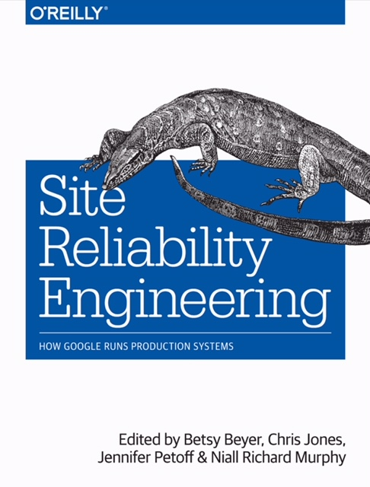
Notes:
[T]
In some ways in this talk we say too much and not enough. There are ideas here, but possibly not enough for you to go and implement it all yourself.
Our suggested next stop is the SRE Book from Google. It gives overviews on all the concepts we introduced here, and more (like how do you monitor this when it’s in place)
[A]
We don't have to scale to a million servers
but we do have to scale to dozens or hundreds of services
and we're too stretched doing that the old way
so you need to be able to pull out the common platform
But you're also able to deploy this incrementally.
So it's not only huge benefit - it's also achievable right now.

Slide 24
Thank you
@NYCDubliner
anna.wilson@heanet.ie
tdeburca@squarespace.com
@yesitsanna

Slide 25
Latency
Traffic
Errors
Saturation
Notes:
Once you have the right tools, you can start to quantify things.
How do we quantify a service? (Golden signals: latency, traffic, errors, saturation)
Let's talk about SLAs
they are scary
But if you don't write one down, your user defines your SLA.
How many of us have "de facto 1 minute SLAs"?
(Doesn't matter if you say "I didn't provide a guarantee" - if everyone in the building is angry at you they’re still angry with you.)

Slide 26
Notes:
You are not the sole provider of your customers' services
So now even if we don't do formal agreements, SLAs, "we'll make it work"
other people we have to work with, do
80/20 rule has reversed. Almost all traffic on a network now leaves the network.

