Slide 1
Regional Networks, Communities and Ecosystems Americas Africa Research and eduCation Lightpaths (AARCLight) Study: Year 1 findings
TNC 2018
10-14 June, 2018, Trondheim, Norway
Julio E. Ibarra, PI
Heidi Morgan, Co-PI
Chip Cox, Co-PI
Luis Lopez, Co-PI

Slide 2
AARCLight: Americas Africa Research and eduCation Lightpaths, NSF Award #OAC-1638990
Planning activity that aims to
Define a strategy for research and education network connectivity between the US and West Africa along the South Atlantic
Coordinate planning efforts among stakeholders in the U.S., Africa, and Brazil
Understand the potential impact
From the use of the offered spectrum
To create economies of scale
Towards serving the broadest communities of interest in research and education

Slide 3
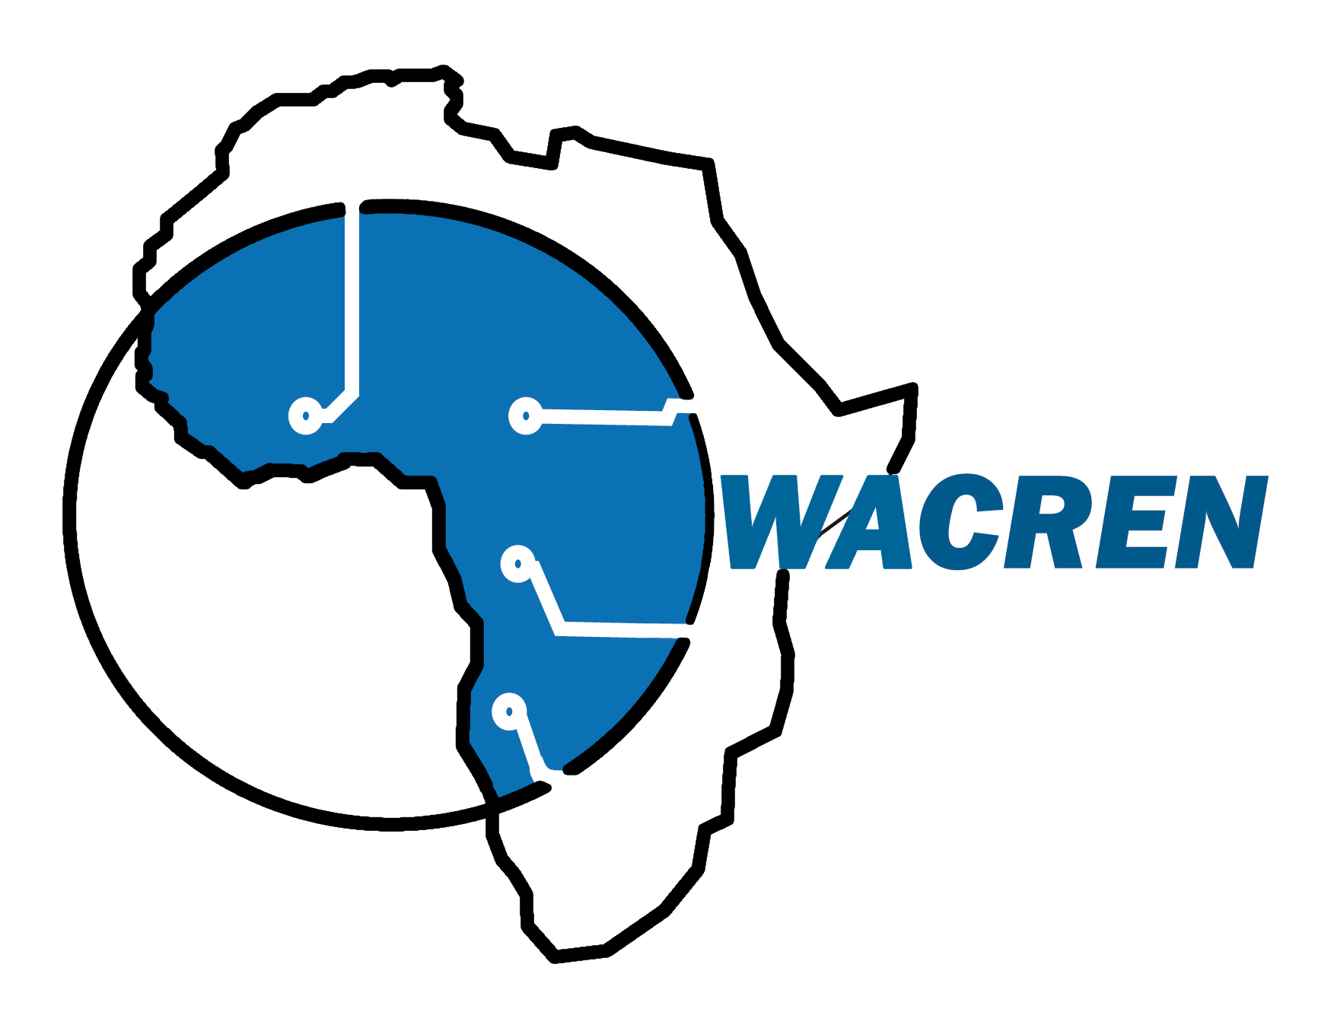
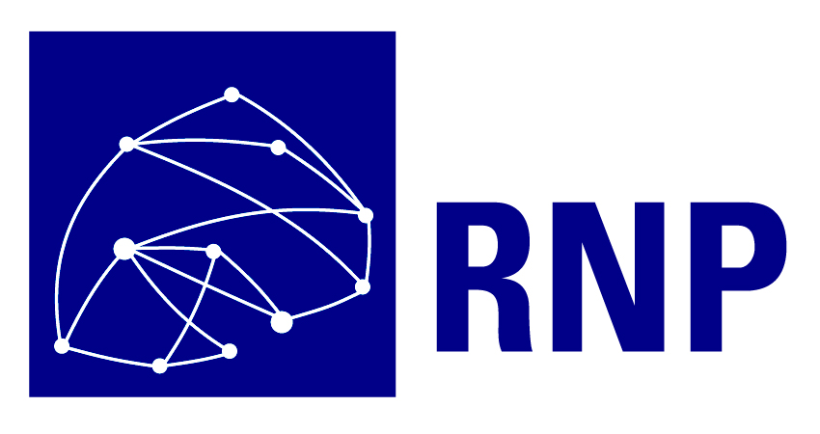
Collaborative Partners
UbuntuNet Alliance
WACREN: West and Central African Research and Education Network
TENET: The Tertiary Education and Research Network of South Africa
SANReN: The South African National Research Network
SABEN: South African Broadband Education Networks
ANSP: Academic Network of São Paulo
RNP: Rede Nacional de Ensino e Pesquisa
CLARA: Cooperation of Advanced Research and Education Networks in Latin America
Internet2
Florida LambdaRail

Slide 4
Indicators to guide the study
New Data-Intensive, Network-Dependent science instruments in the southern hemisphere:
Large Synoptic Survey Telescope (LSST) in Chile
SKA in South Africa and Australia
New submarine cables in South Atlantic
Network aggregation emerging in the southern hemisphere
Potential to leverage network infrastructure linking the U.S., South America, and Africa

Slide 5
MeerKAT Radio Telescope
MeerKAT is a 64-dish system
MeerKAT will be integrated into the mid-frequency component of SKA
Generates data at a rate of 4.7Gbps
Data is transported either by tapes, or scientists travel to South Africa
Data is collected and digitized at each antenna and then streamed via optical link to the Karoo Array Processor Building (KAPB) for science processing
Clock signal is distributed from a central point to remote dishes
Notes:
Is data collected at each antenna or are the antennas connected to a network that transports the data to a data center?
Data is collected at each antenna, then undergoes processing to convert the signal into digitized radio frequencies, and then sent via optical link for science processing. See below (http://www.scielo.org.za/scielo.php?script=sci_arttext&pid=S0038-23532017000300020):
In the 64-dish MeerKAT array, for example, a digitiser will be installed on each dish so as to convert the received electromagnetic wave from a radio frequency (RF) into a digital signal. The received radio astronomy signals will be digitised using an analogue digital converter and sent via buried optical link for science processing.

Slide 6
SKA Data Transport Requirements
SKA will be the world’s largest radio telescope
Australia and South Africa are the host countries
SKA Regional Science and Engineering Centers (SRC) will provide access to
SKA data products
Computational resources for processing and analysis
A long-term archive for SKA science data products
NRENs will be critical to support data movement to SRCs and users
0.68 Tb/s
3.6 Tb/s
100Gb/s
100Gb/s
(7.2 Tb/s)*
3.2 Tb/s
3.8 Tb/s
7.4 Tb/s
Science Data Products
SKA1_Low
SKA1_Mid
Adapted from Richard Hughes-Jones
By Richard Hughes-Jones
()* – if digitised
Notes:
Data products are transported from the SDP to the regional SKA data centers. This network is not shown in the diagram. Where is there a diagram and description of the network from the SDP to the regional SKA science centers?
It looks like all of the regional science centers have not been decided upon yet. Here is a white paper detailing the cooperation between regional centers in Australia (domestically through AARNet), New Zealand, China, and the international community, and a figure of the regional (South Asian Pacific) and international cooperation thus far. The acronym meanings can be found on page 3.
https://drive.google.com/file/d/1at3yP3NZ8Xqta1O0hpF56p8ob5wOLpfP/view
See also this powerpoint presentation from the SKA Regional Science Center Coordination Group (SRCCG), IN PARTICULAR SLIDE 3. Again, it looks like there are just projected locations for the regional centers based upon member country locations.
https://indico.cern.ch/event/570594/contributions/2362506/attachments/1365525/2068447/SRCCG_20161103b.pdf

Slide 7
Network performance to Latin America
Latency was measured from Cape Town to the following sites:
Miami 272ms
Sao Paulo 381ms
Santiago 382ms via Pacific
Santiago 430ms via Atlantic
La Serena 392ms
Academic networks transited were TENET, UbuntuNet, GEANT, Internet2, AmLight, REUNA, RNP and ANSP
Miami - Cape Town
Sao Paulo - Cape Town
Santiago (Pacific) - Cape Town
Santiago (Atlantic) - Cape Town
La Serena - Cape Town
Notes:
Report on measurement data provided by Len Lotz.
Packet trajectory is from south to north, then to west, then to south.
Simulate latency going from south to south, then north.

Slide 8
New submarine cables in the South Atlantic
Monet: Boca Raton, FL-Fortaleza, BR. Operational
South Atlantic Cable System (SACS): Fortaleza, BR– Sangano, Angola. Q3 2018
South Atlantic Inter Link (SAIL): Fortaleza, BR – Kribi, Cameroon. Q3 2018 (TBD)
EllaLink: Fortaleza, BR – Sines, Portugal. RFS 2020
America Movil (AMX-1): Fortaleza, BR – Jacksonville and Hollywood, FL. Operational
SABR: Cape Town, SA – Recife, BR. RFS 2019
Fortaleza is a landing point for all cables, except for SABR
Notes:
Add SABR cable to the map.
Add bullets.

Slide 9
Network infrastructure resources in the Southern Hemisphere (potential leveraging)
225GHz linear spectrum of Monet committed in AmLight-ExP project
40GHz of spectrum on SACS is available to the R&E community
TENET operates 220G of capacity on WACS
South Atlantic eXchange point (SAX) is under development in Fortaleza, led by RNP
R&E exchange point in Cape Town operated by SANREN and TENET
R&E exchange point in Lagos, operated by WACREN

Slide 10
Findings in Year 1
Data volume will be increasing from science drivers in Sub-Saharan Africa (SSA)
Network infrastructure capacity is increasing in the Southern Hemisphere
Linking the R&E communities in the US, Africa and Brazil is realizable via Monet and SACS submarine cable systems
Reducing latency and improving infrastructure diversity is realizable
Human resource development in several science, engineering and technology areas is lacking
Notes:
Data volume will be increasing: Reasons: MeerKAT and SKE
Network infrastructure capacity increasing: SACS, Monet and WACS. Mention also the development of the NRENs; regionals, such as WACREN; progress through AC2.

Slide 11
Year 2 Goals
Develop a plan for the activation of the offered spectrum on SACS
Study locations for interconnections with partners’ R&E networks in Africa
Develop a network design with AARCLight collaborators
Develop an assessment plan to measure the level of engagement by communities of interest with the potential new network infrastructure

Slide 12
Acknowledgment
National Science Foundation (NSF) awards OAC-1638990, and OAC-1451025
Dr. Heidi Morgan, Gabriella Alvarez, and Vasilka Chergarova for their contributions
Academic Networks of Sao Paulo, RNP, SANREN/TENET, UbuntuNet and WACREN for their participation and support
The many national and international collaborators who support our efforts

Slide 13
THANK YOU! julio@fiu.edu

