Slide 1
Orchestrating the Programmable Network
ESnet6 Software Strategy
John MacAuley
ESnet - Software Engineering Group
Lawrence Berkeley National Laboratory
Trondheim, Norway
June 13, 2018

Slide 2
What is orchestration?
Orchestration is the automated arrangement, coordination, and management of computer systems, middleware, and services.
-- Wikipedia
Workflow management for user-based interactions with our operations support system;
Automated service provisioning across network, compute, and application resources.

Slide 3
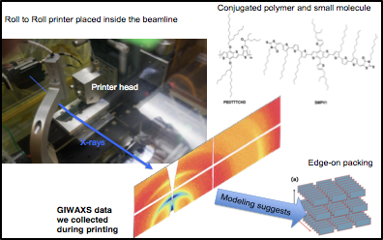
Science progress will be completely unconstrained by the physical location of instruments, people, computational resources, or data.
ESnet vision
Large Hadron Collider Science
Advanced Light Source → NERSC
Linac Coherent Light Source → NERSC

Slide 4
ESnet5: Where we are today

Slide 5
ESnet5 at a glance
Nodes
Ports
Services
329 optical transport
102 switches
57 routers
209 “other”
415 optical
2,646 Ethernet
285 optical circuits
353 MPLS LSP
212 BGP peerings
Notes:
ESnet6 will have a similar number of Nodes with higher density cards and increased bandwidth capabilities per port.

Slide 6
Tasks and their tools in ESnet5
ESnet5
Inventory, Modeling, and Planning
Provisioning
Monitoring and Reporting
Troubleshooting
Security
Installation
nfdump
Notes:
Inventory, Modeling, and Planning (Planning team)
Multiple sources of data for the network:
Hand curated data stored in multiple locations (ServiceNow, ESDB, Visio, Google Sheets);
Some automation of data discovery (inventory from network, flow data, etc.)
Opportunity to consolidate some sources of data.
ServiceNow used to track DoE tagged network assets.
Visio diagrams used to track network design.
Equipment inventory (line cards and interface optics) discovered using screen-scraping of equipment CLI and tracked on Google sheets.
Packet Design and Graphite applications provide traffic analytics used for network planning.
Topology is derived using data collected via SNMP from the devices.
ESDB used to maintain hand curated Network inventory (circuits and services).
Provisioning (Network Engineering)
Primary interaction with devices through direct command line access and customized scripts.
OSCARS for L2VPN provisioning.
Performance testing of new circuits using perfSONAR/iperf.
Monitoring and Reporting (Tier 1 – Network Operators)
Swivel chair management solution
Eyes required on multiple tools to perform monitoring of the network.
CA Spectrum for network equipment and opsview for infrastructure monitoring.
Third-party tools deployed for fault monitoring functions
Standard "out of the box” deployment with minimal customization.
ESnet developed tools to address specific monitoring needs
ESDB for circuit information and contacts;
Planned Maintenance Calendar for tracking planned and unplanned outages;
Netlog for log management.
Improved workflows with customized integrations
ServiceNow ticket integration with Spectrum alarms;
Limited integration between monitoring and Planned Maintenance Calendar (PMC).
Troubleshooting (Tier 2 – Network Engineering)
Fault monitoring/history using CA Spectrum for network equipment and opsview for infrastructure monitoring.
System logs using netlog and splunk.
Flow analysis using Arbor, graphite, and nfdump.
Performance testing using perfSONAR/iperf.
Network inventory using ESDB.
Ticket management using ServiceNow.
SSH command line for direct network element access.
Security (Security team)
Log monitoring/history using Splunk.
Network security monitoring (IDS/IPS) using Bro and Suricata.
Flow data and analysis using Arbor and nfDump.
Ticket management using ServiceNow.
Site coordinators/Scientists
Portal for port bandwidth visualization and outage information.
E-mail/phone to contact NOC for issue resolution or new service provisioning.
NSI or OSCARS for scientist dynamic provisioning of Layer 2 VPN services.

Slide 7
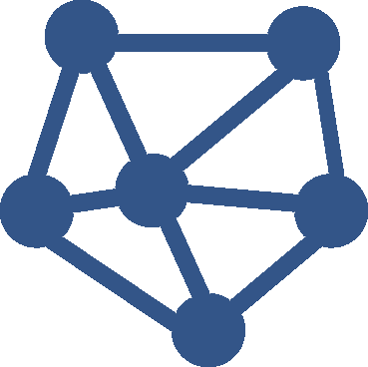
Provisioning: State of the art in ESnet5
A. Service Request
User calls/emails request to ESnet operations.
Change request is created in ServiceNow as a ticket by ESnet operations.
Ticket is assigned to ESnet engineer.
ESnet engineer calls/emails user to clarify requirements.
B. Service Planning
ESnet engineer determines policies applicable to service request.
ESnet engineer designs the service, determining if sufficient resources are available to satisfy the request.
If new physical connectivity is required the ticket is routed to ESnet planning team.
ESnet engineer provisions service information within ESDB (inventory system).
ESnet engineer generates new device configuration from ESDB using scripts.
Pull request containing configuration change is submitted to git for review.
Peer review of configuration changes - accepts or rejects pull request based on correctness.
Current service turnaround can take days. Could we not do better?
C. Service Provisioning
ESnet engineer pushes approved configuration change to device using script or cut-and-paste into ssh.
ESnet engineer validates configuration was properly applied to network.
ESnet engineer closes ticket in ServiceNow.
ESnet engineer calls/emails customer informing completion of service operation.

Slide 8
Lessons learned from ESnet5
Disjoint set of software components and tools
Limited network programmability
Ad Hoc data collection
Lack of centralized configuration management
Reactive not proactive
Notes:
Disjoint set of software components and tools
Multiple tools with partially overlapping functionalities;
Varying semantics across vendors;
No single vendor can offer an overall coherent solution for our network.
Limited network programmability
Screen scraping has become the modus operandi;
Poor performance, varying command structures, and differing behaviors lead to error prone complex code.
Ad Hoc data collection
Multiple protocols with inconsistent coverage;
Lack of key statistics;
Primarily polling interfaces provide limited query rates, makes “real-time” impossible, and can result in statistic loss.
Lack of centralized configuration management
Network is typically configured manually one node at a time;
Limited view of inconsistencies between network devices;
Limited automated end-to-end service provisioning.
Reactive not proactive
Break/fix operations versus proactive;
Mainly lower level tactical operations using localized information;
Some network wide flow planning but not the norm.

Slide 9
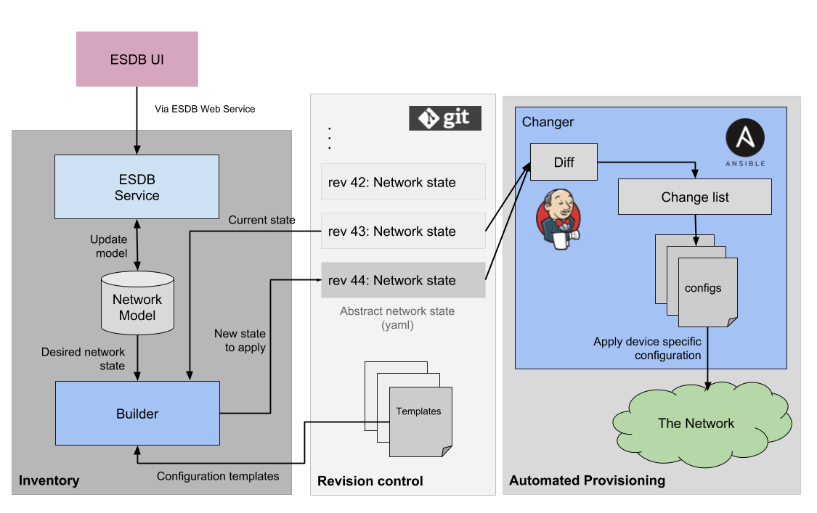
Taking a step forward in ESnet5

Slide 10
ESnet6: The road to automation

Slide 11
ESnet6 “Hollow-Core” network architecture
Workflows
and Automation
Services Edge
Programmable, Flexible, Dynamic
Monitoring and Measurement
“Hollow-Core”
Programmable, Scalable, Resilient
Core Switch Router
Optical Services Transponder
Platform
Compute Cluster
Data plane Programmable Switch
Open Line System
“Hollow” Core
Programmable – Software driven APIs to allocate core bandwidth as needed, and monitor status and performance.
Scalable – Increased capacity scale and flexibility by leveraging latest technology (e.g. FlexGrid spectral partitioning, tunable wave modulation).
Resilient – Protection and restoration functions using next generation Traffic Engineering protocols (e.g. Segment Routing).
Services Edge
Programmable – Software driven APIs to manage edge router/switch and retrieve telemetry information.
Flexible - Data plane programmable switches (e.g. FPGA, NPU) in conjunction with compute resources to prototype new services (driven by Software Defined Networks)
Dynamic – Dynamic instantiation of services using SDN paradigms (e.g. Network Function Virtualization, service chaining).
Network Appliance
Notes:
Design vs Implementation
(Integrated Packet Core and “Low-Touch” Path Services Edge Network Elements)
Separating functional requirements in the design phase allowed us to clearly delineate roles and responsibilities of network elements (i.e. distinct PE (i.e. Services Edge) and P (i.e. Core) routers).
However based on vendor platform investigations, we determined that it was possible to collapse the multiple roles into a single chassis (i.e. combined PE/P router).

Slide 12
Services in ESnet6

Slide 13
ESnet6 software strategy
Provide increased flexibility to support workflows of growing complexity
Focus on developing integrations that reduce operational complexities
Develop a software architecture utilizing sound design patterns
Clearly defined source of truth for all configuration data
Leverage proven cloud technologies
Notes:
Provide increased flexibility to support workflows of growing complexity
Utilize current industry trends towards improved programmable devices;
Facilitate programmability of network services using well defined API and models;
Provide workflow oriented user interfaces to guide service provisioning.
Focus on developing integrations that reduce operational complexities
Utilize existing software solutions where applicable;
Provide value added higher-order integrations;
Utilize best-in-class components to assemble an overall cohesive solution;
Reduce tool bloat where possible.
Develop a software architecture utilizing sound design patterns
Workflow management and automation;
Normalized data model, well defined API, and device mediation;
“Focused” distributed components (encapsulated functions, low coupling API, dynamic deployment);
Scalable processing and data storage.
Clearly defined source of truth for all configuration data
Reduce data bloat and operational errors by maintaining a single “master” within the network.
Perform actual versus intended audits of all data to identify inconsistencies.
Leverage proven cloud technologies
Whether locally or remotely hosted, cloud technologies have matured into a reliable scalable runtime solution.

Slide 14
ESnet6 software pillars
Enhanced User Experience (intent-based API, self-service portal, workflow-based console)
Intelligent Assurance
Automated
Fulfillment
Adaptive Security
Reactive Analytics
Unified Data Model
(source of network truth)
Normalized Mediation
(adaptation to standard API and model)
API Driven Network
(programmable, agile, flexible)
External/Back Office Systems
(process oriented integrations)
Notes:
API Driven Network aka Software Defined Network
Direct Programmability
Standards-based programmatic access to all network device capabilities;
Fast and responsive API with asynchronous notification capabilities;
Programmable data plane for control over individual data flows;
Fine grained streaming telemetry.
Agility and Flexibility
Underlying infrastructure abstracted for applications and network services provides greater development velocity.
External/Back Office Systems
Import/Export of operations related data utilized in the unified data model from systems not integrated into the core.
Can include specific orchestration invocations from external systems (i.e. ServiceNow).
Normalized Device Mediation
Adapts between the internal normalized model behaviors, and well API into the device/external systems specific representation.
Unified Data Model
A normalized model required to implement our services, OAM&P functions, and orchestrations.
Intelligent Assurance
Automated fault management and resolution
Intelligent presentation of first alerts;
Precise service/fault correlation;
Automated root cause analysis to filter out the noise.
Proactive monitoring to reduce faults that are customer visible
Automated fault correction and mitigation;
SLA management.
Performance visualization
Early warning of service impacting trends.
Ticket management
Automated ticket generation;
Automated incoming ticket processing.
Automated Fulfillment
Zero touch provisioning through automation
Centralized workflow tooling to reduce engineering effort;
Centralized configuration management and validation.
Service ordering through customer portal
Customers declare their intent via web interface;
Quick service delivery, potentially nearly instantaneous.
Reactive Analytics
Rebalance network traffic based on current load
React to current conditions;
Based on up up to the minute measurements;
Explore machine learning approaches.
Predict network failures and take corrective action
Leverage analytics and machine learning to identify events;
Use orchestration to instantiate change in the network.
Built on a flexible and scalable platform
Low latency access to real time data;
Computational power for in depth analysis;
Enables evolution and exploration of new algorithms.
Adaptive Security
Automated detection of bad actors
Anomaly detection using analytics capabilities;
Automatically detect security anomalies and take defensive action when possible.
Customer assistance services
Black hole routing;
DDOS filtering;
BGP Protection;
Vulnerability scanners;
Upstream peer filtering;
Configurable through customer portal.
Virtualized Network Functions
Security as a service spun up on demand.
Enhanced User Experience
Intent based API
Engineers decide “what” should be done;
System handles the “how” to do it.
Unified console for engineering and operations
Single point of access for all management functions;
Comprehensive visualization dashboard.
Self service customer portal
Service monitoring capabilities;
Simple ordering functions;
Customer accessible API.

Slide 15
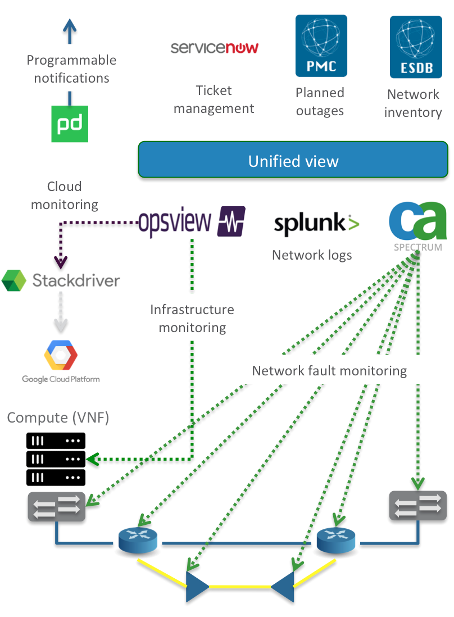
Intelligent Assurance Monitoring and troubleshooting the network
Fault Management
Evolution is to provide single fault view for network operators;
Integrates network devices, compute, NVF resources, and cloud resources into fault stack.
Ticket Management
Automated ticket generation based on fault detection;
Automated fault to planned/unplanned outage events;
Automated incoming ticket processing.
Automated fault management and resolution
Intelligent root cause alarm filtering performed (Spectrum);
Service/fault correlation and mitigation (PMC).
Troubleshooting
Vendor specific NMS for FCAPS access when needed.

Slide 16
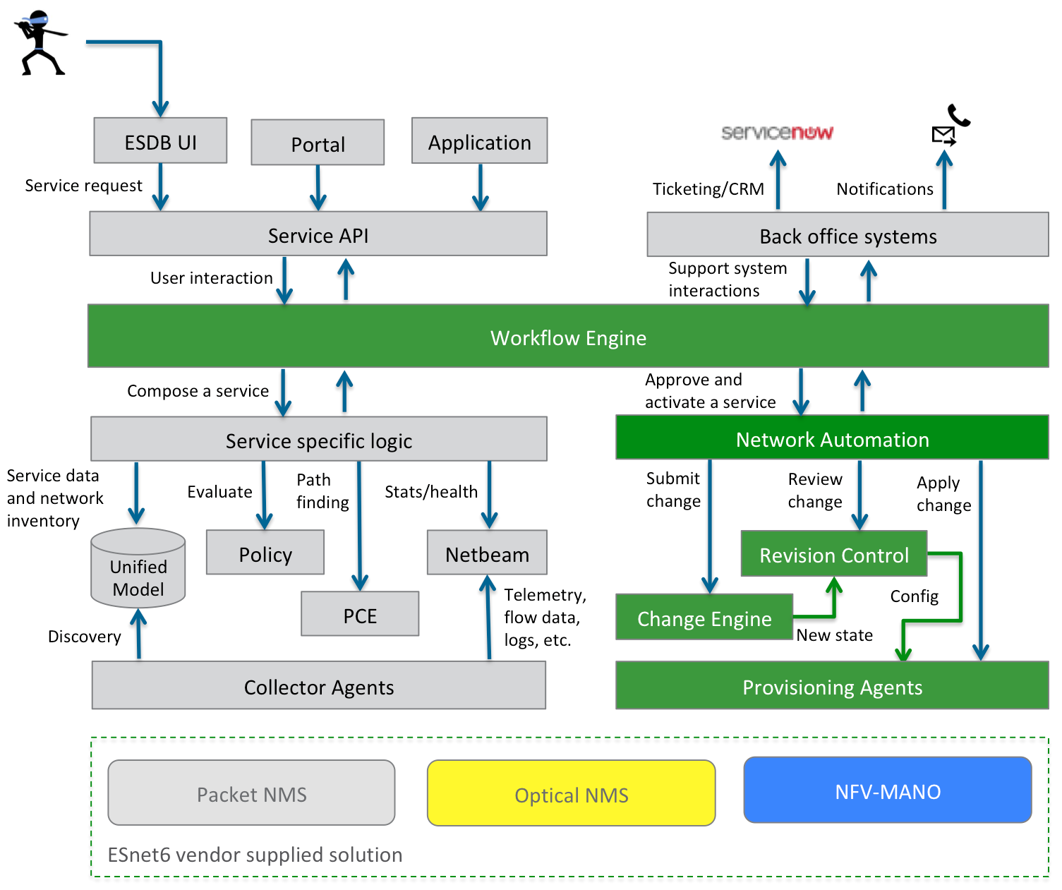
Automated Fulfillment Orchestrating service workflows
Workflow automation
ESnet6 services within an extended ESDB user interface supporting task workflows;
Automated network configuration management including a formalized change review process for both networking and NFV resources;
Multi-layer/technology Path Computation Element (PCE) for orchestration of network services.
Network discovery
Equipment inventory, configuration, and topology discovery;
Intended versus actual configuration auditing;
Manual provisioning of network information that cannot be dynamically discovered.
Vendor specific Network Management System
As an interface into the managed network;
For provisioning operations not covered by implemented service workflows (infrequent operations).

Slide 17
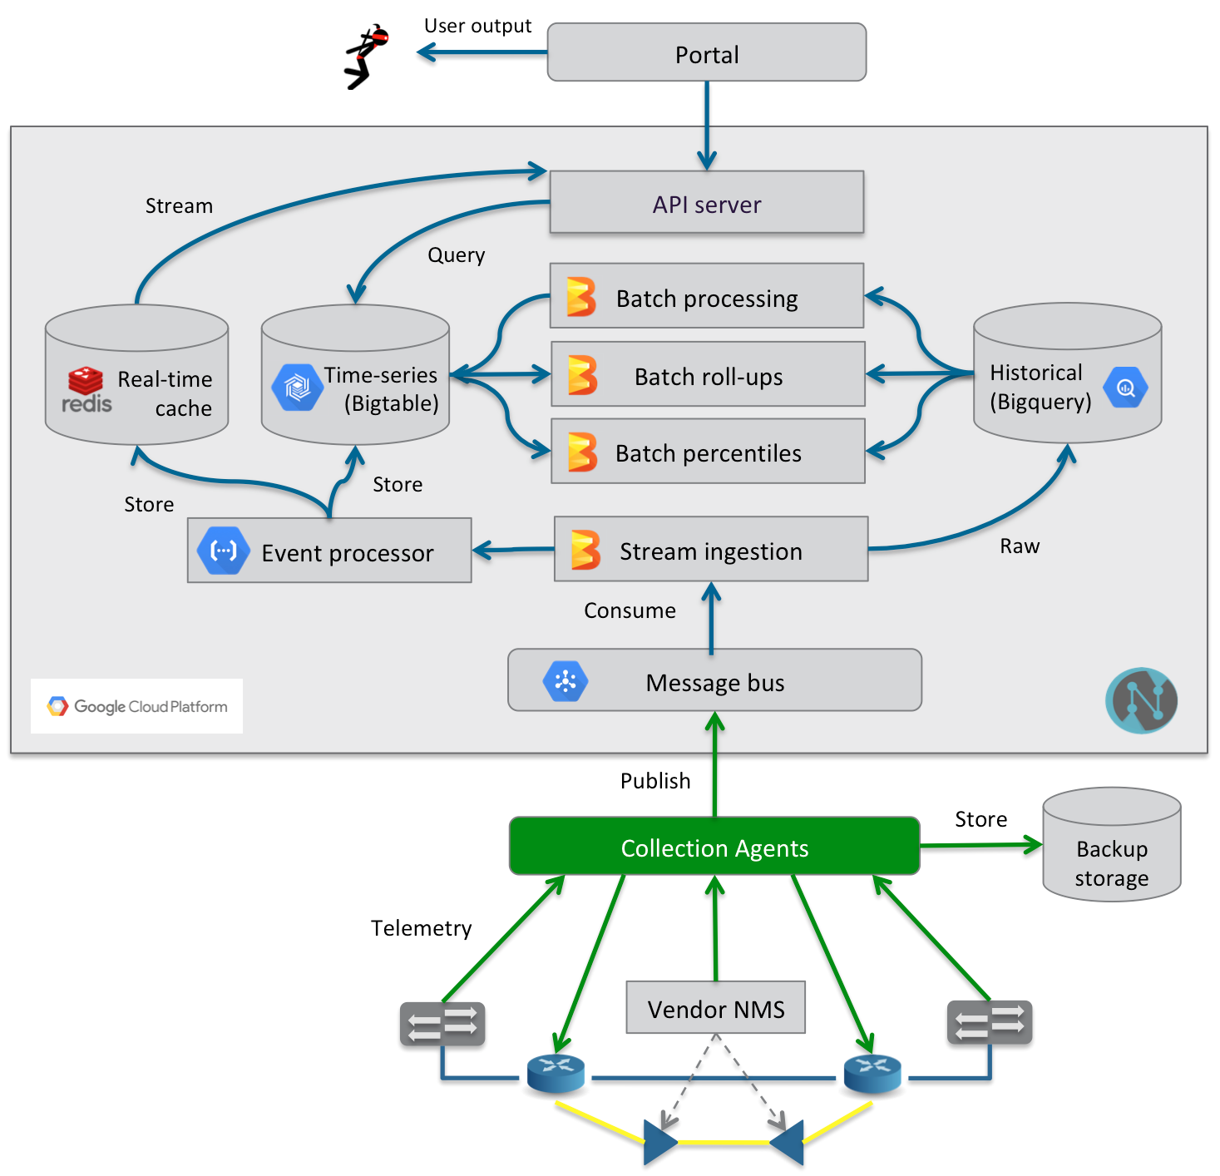
Reactive Analytics Collecting and analyzing network data
Scalable network data collection infrastructure implemented on the Google Cloud Platform (Netbeam)
Low latency access to real time and historical data in scalable storage;
Elastic computational power for in depth analysis and bulk processing;
Collection, time-series creation, and archiving of network telemetry data; flow data; faults, logs, and meta-data.
Well-defined API for application access to stored data sets.
Data visualization (MyESnet Portal)
Provide tailored views and analysis of network statistics;
Network heat maps;
Per site and per port views;
Generation of historical reports.
Event processing infrastructure
React to sequences of events within the network to take corrective action;
Leverage analytics and machine learning to identify events.
Notes:
Apache Beam == Google Cloud Dataflow

Slide 18
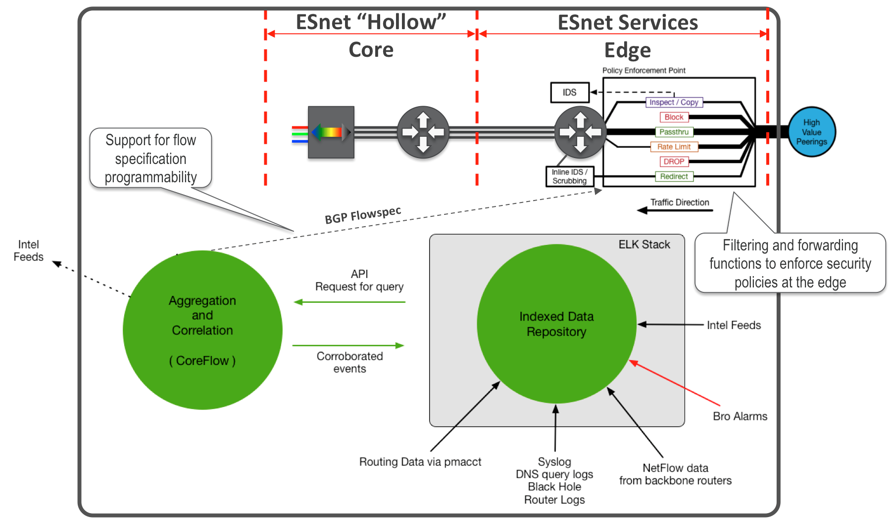
Adaptive Security Proactive monitoring of the network
Proactive and reactive security (CEASE)
Active scanning of internal network resources aggregated via Splunk;
Baseline deviation and anomaly detection using the CoreFlow complex event processing engine;
Intelligent filtering of undesirable traffic through reactive control of network;
Configuration of CEASE
Self service for site coordinators through portal;
Access controlled resource views;
Audits and reporting.

Slide 19
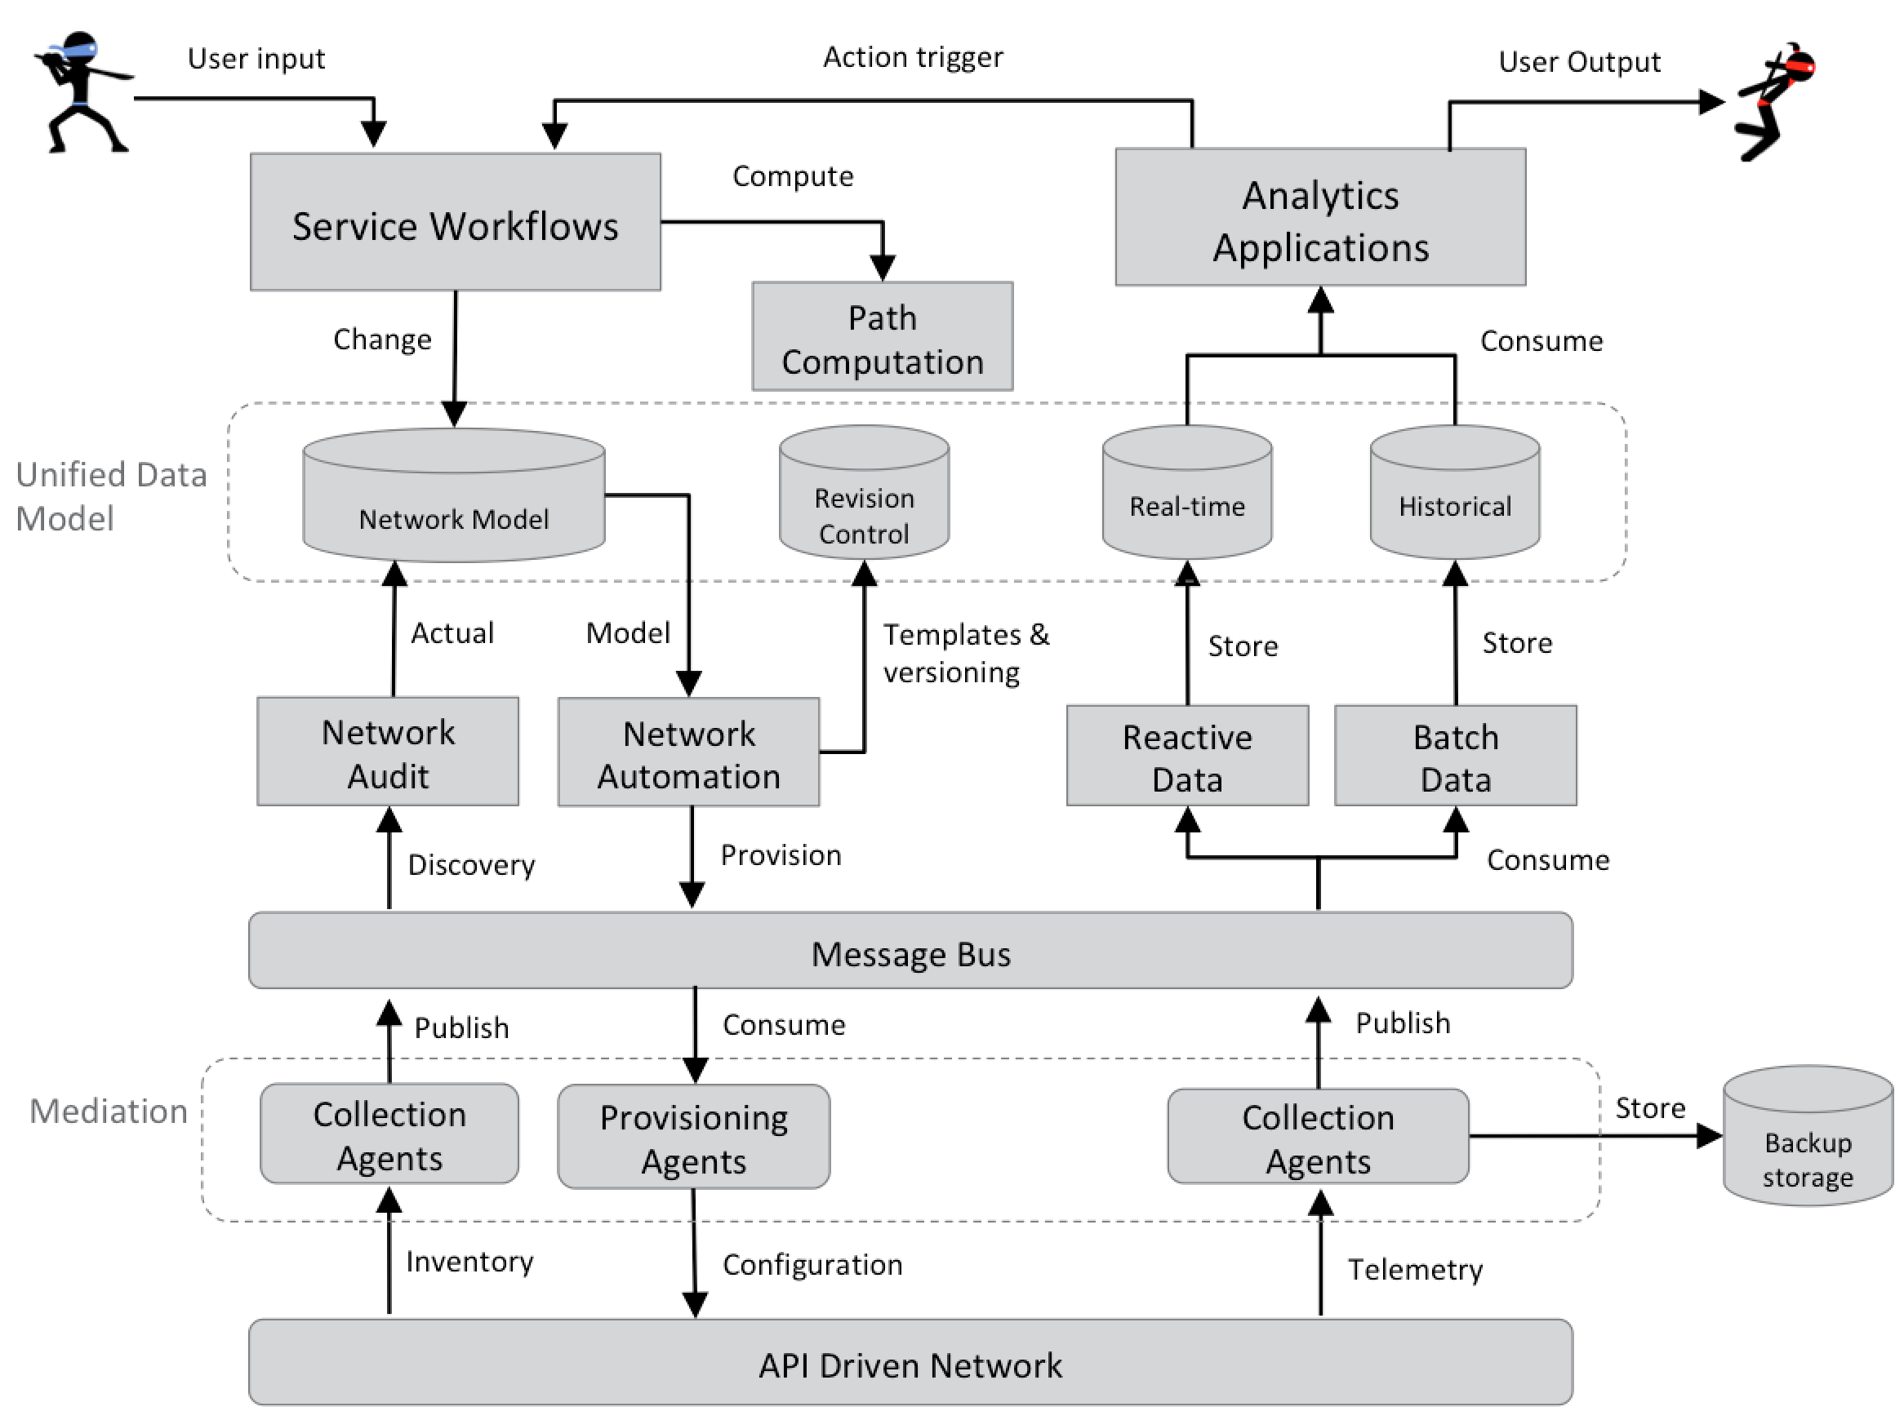
Architectural “feedback” pattern
Service workflows exposing intent-based API and driving service lifecycle;
Network discovery building accurate network inventory and topology used to drive actual versus expected audits;
Network automation to dynamically provision services within the network;
Analytics to collect, process, and trigger actions based on network events;
Rinse and repeat as needed.
Notes:
Service Workflows
Programmable template driven workflows.
Exposes programmable API for use by other automated components.
Exposes interface for network engineers to express intents for networking functionality.
Scalable to seamlessly handle additional orchestration loads.
Path Computation
Utilizes network topology and current network load to determine optimal paths for new services.
Unified network model
Scalable to high query counts.
Source of truth, normalized, and consistent.
Provisioning Engine
Centralized management of network element configuration.
Automates validates provisioning of network elements and offered services.
Event processing engine
Rule based filtering.
Reacts to events and invokes corrective actions.
Machine learning engine
Using trained models to classify events.
Time series database
Reactive - High speed real time database for quickly accessible views.
Batch - Bulk data storage for accurate historical data view.
Scalable processing
Processing and storage grows on-demand.
Allow for smooth handling of dynamic traffic volume and researching new functions and methods.
Message Bus
Topic/subscription based messaging service.
Guaranteed message delivery.
High message throughput rates.
Data specific mediation agents
Scalable to handle network load.
Normalize network data to unified model.
Use out of the box solutions where possible.
Highly programmable network devices
Programmable API covering all network device capabilities.
Asynchronous notification support.
Fast manipulation of fine grained data flows.
Streaming telemetry for all metrics.

Slide 20
macauley@es.net

Slide 21
Actors in ESnet
ESnet
Network Planning
Network Engineering
Network Security
Scientists
Science Engagement
Network Operations
Users of our network services – can use NSI/OSCARS to request dynamic layer 2 Ethernet services, or request other new services through site coordinator.
Name says it all… analyze existing network, plan new bandwidth expansion, and plan new services.
Tier 2 support staff troubleshooting issues within the network and provision new network services.
Our primary contact at a site – requests new services from NOC; monitors existing services using ESnet tools; and reports networking issues to NOC.
Site Coordinators
Tier 1 support staff monitoring the network, servicing end user requests, and opening tickets for issues within the network.
Provide security services and mitigation during network incidents.
Run requirements workshops with our end users (facilities and universities) and show these users how ESnet can help improve their networking workflows.
Infrastructure
Maintain the OAM&P infrastructure, compute, and applications.
Notes:
Network Planning
Name says it all… analyze existing network, plan new bandwidth expansion, and plan new services.
Network Engineering
Tier 2 support staff troubleshooting issues within the network.
Provision new network services.
Network Operations
Tier 1 support staff monitoring the network, servicing end user requests, and opening tickets for issues within the network.
Network Security
Provide security services and mitigation during network incidents.
Infrastructure
Maintain the OAM&P infrastructure, compute, and applications.
Science Engagement
Run requirements workshops to gather networking requirements from our end users (facilities), and universities.
Work with facilities to show how ESnet can help improve their networking.
Troubleshoot facility workflow performance issues to improve the scientists experience.
Can verify connectivity using perfSONAR if so desired.
Site Coordinators
Our primary contact at a site.
Monitors services through portal (limited).
Reports network issues via e-mail or calling NOC.
Requests new services using e-mail to network engineering team.
Portal for port bandwidth visualization and outage information.
E-mail/phone to contact NOC for issue resolution or new service provisioning.
Scientists
Users of our network services.
Reports network issues through site coordinator.
Requests new services through their site coordinator or via requirements workshops.
Can use NSI/OSCARS to request dynamic layer 2 Ethernet services.

Slide 22
Guiding design principles
Zero touch self regulating network
Highly available fault stream
Engineers must always be able to take corrective action
Notes:
Zero touch self regulating network
Avoid manual intervention in the daily operations of the network;
Prioritize automation of frequent operations over infrequent ones;
Manage network via a declarative interface.
Highly available fault stream
Without fault the operational state of the network is unknown;
A basic fault monitoring system must always be available.
Engineers must always be able to take corrective action
If orchestration/automation is not available then EMS or direct CLI access is acceptable.

Slide 23
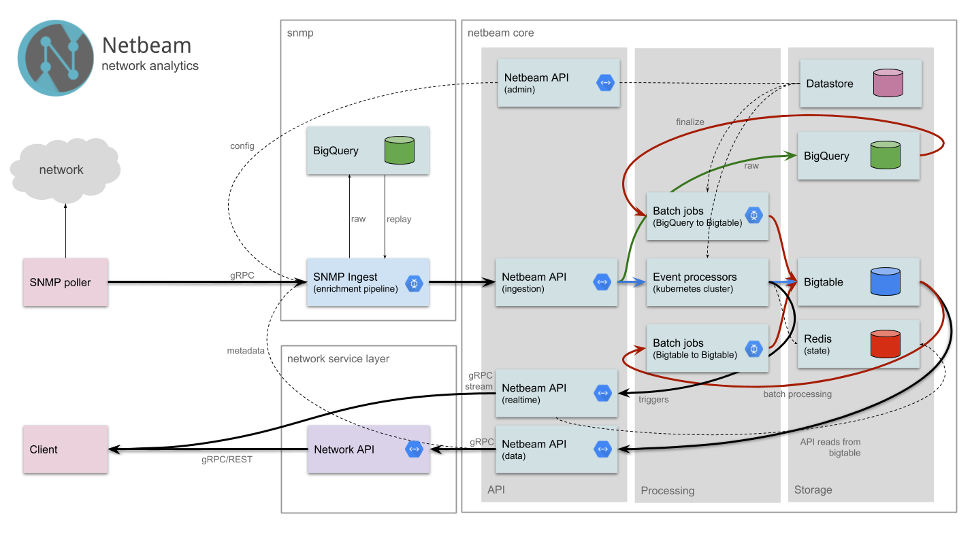
Netbeam for scalable data and analytics
Data collection and archiving
SNMP statistics, OpenConfig telemetry, NetFlow data.
Meta-data
Data processing
Statistics alignment and data augmentation;
Time series generation for meta-data and statistics;
Historical archiving and real-time caching.
Data presentation
Both real-time and historical views;
Query and notification based services;
Customized network API for portal-based views.
Notes:
Data collection and archiving
SNMP statistics, OpenConfig telemetry, NetFlow data.
Meta-data
Data processing
Statistics alignment and data augmentation;
Time series generation for meta-data and statistics;
Historical archiving and real-time caching.
Data presentation
Both real-time and historical views;
Query and subscription based services;
Customized network API for portal-based views.

Slide 24
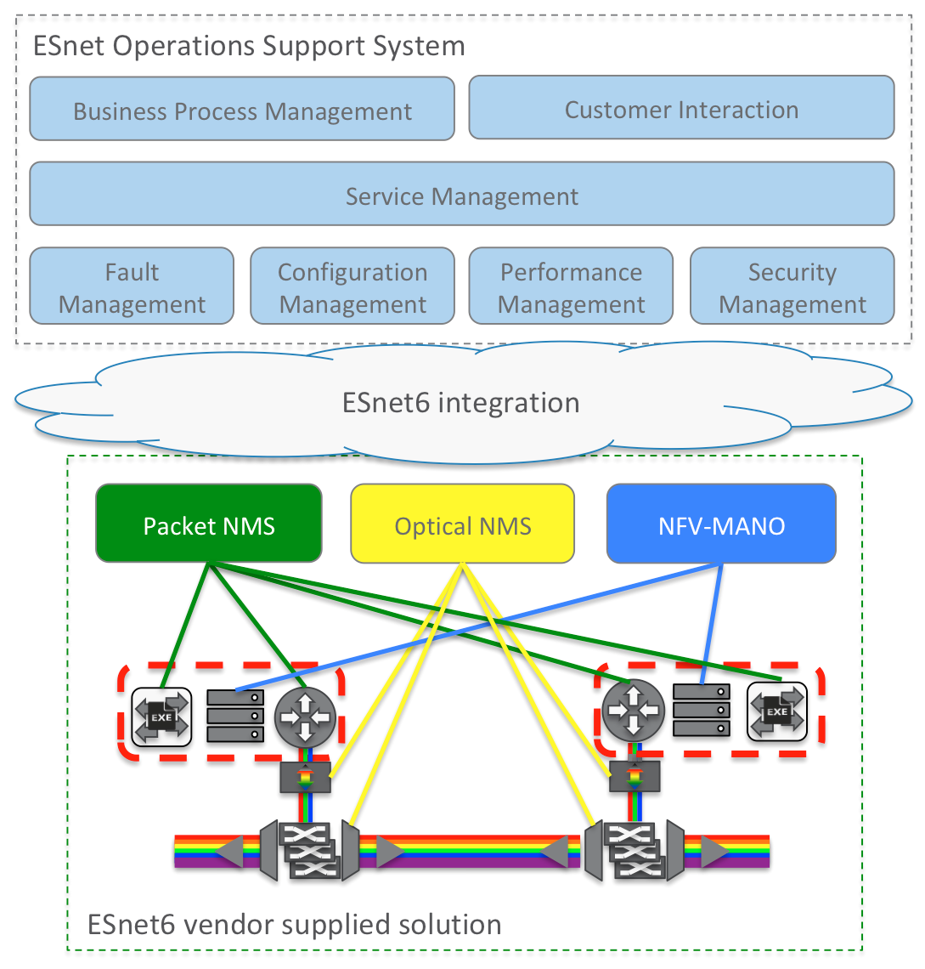
ESnet Operations Support System

